Slide 1
Aqualean Product Presentation
By Laurent Domenget
Product Manager, Rooftop & Packaged Air Units

Slide 2
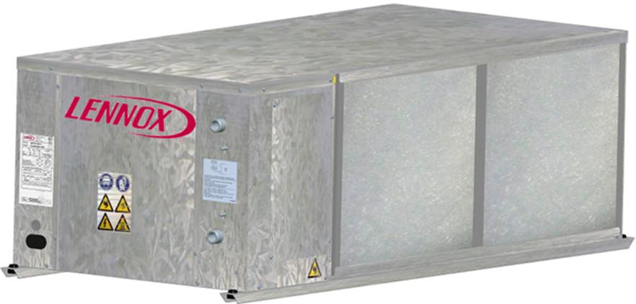
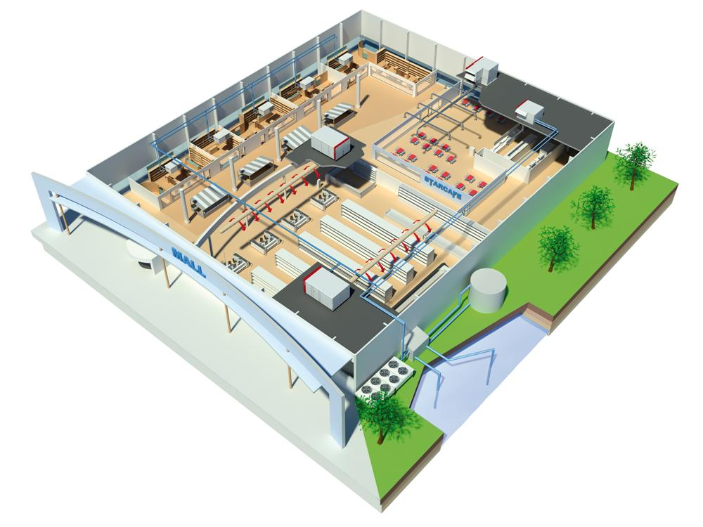
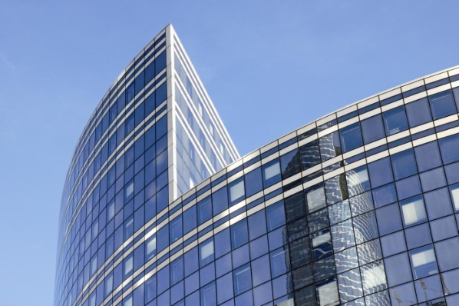
AQUALEAN - Introduction
Water-to-Air Packaged Unit (air conditioner)
Cooling only or Reversible
From 2 to 20 kW
For buildings equipped with a water-loop:
Open-plan and cellular office buildings
Hotel rooms
Shopping areas
…

Slide 3
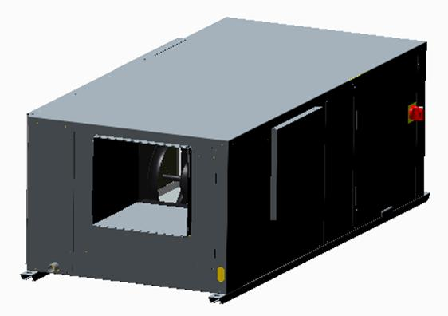
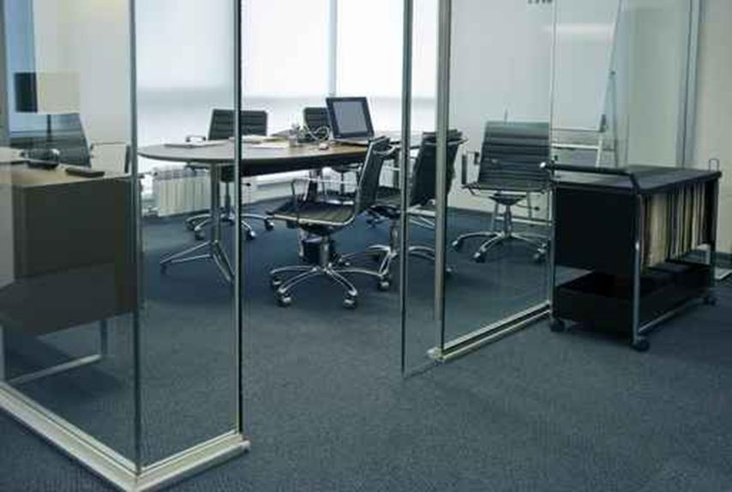
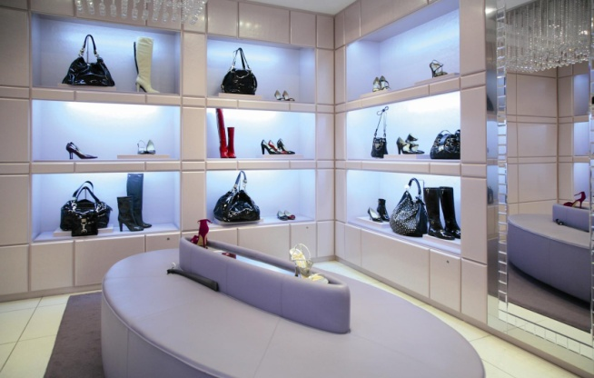
AQUALEAN - Main Characteristics
High efficiency system connected to a water loop (balanced or unbalanced water loop)
R410 Scroll compressor & Electronic expansion valve
Compact solution and reduced height for easy integration in narrow dropped-ceiling
Ceiling installation for sale surface optimization
Quiet operation thanks to variable speed fan motor
Low energy consumption with airflow rate variation
Zoning requirements in cellular office buildings
Independent consumption monitoring and maintenance
Wide communication interfaces (ModBus, LonWorks, BACnet)
Fireproof insulation

Slide 4
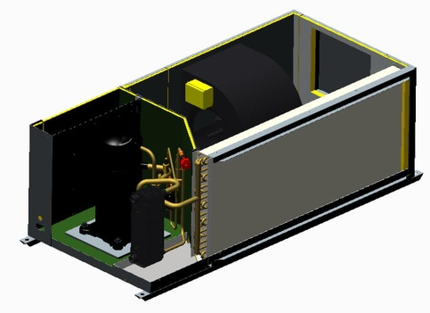
AQUALEAN - Range
COOLING
AQUALEAN | 002 | 003 | 007 | 008 | 010 | 012 |  | 015 | 018 | 020
Net Cooling Capacity (kW) | 2,2 | 2,7 | 6,8 | 8,0 | 10,2 | 11,2 |  | 14,5 | 17,0 | 19,0
Net EER | 4,2 | 4,2 | 4,0 | 3,9 | 4,0 | 4,0 |  | 4,3 | 4,1 | 4,0
Voltage | 230V/50Hz/1Ph |  |  |  |  |  | 400V/50Hz/3Ph
Cooling limits
Cooling condition: Air inlet temperature 27°C DB/19°C WB – Water inlet temperature 30°C at nominal water flow
HEATING
AQUALEAN | 002 | 003 | 007 | 008 | 010 | 012 |  | 015 | 018 | 020
Net Heating Capacity (kW) | 2,9 | 3,3 | 8,0 | 9,5 | 12,3 | 13,5 |  | 17,0 | 19,5 | 22,0
Net COP | 4,5 | 4,6 | 3,8 | 3,8 | 3,9 | 3,8 |  | 3,7 | 3,8 | 3,6
Voltage | 230V/50Hz/1Ph |  |  |  |  |  | 400V/50Hz/3Ph
Heating limits
Heating condition: Air inlet temperature 20°C DB – Water inlet temperature 20°C at nominal water flow

Slide 5
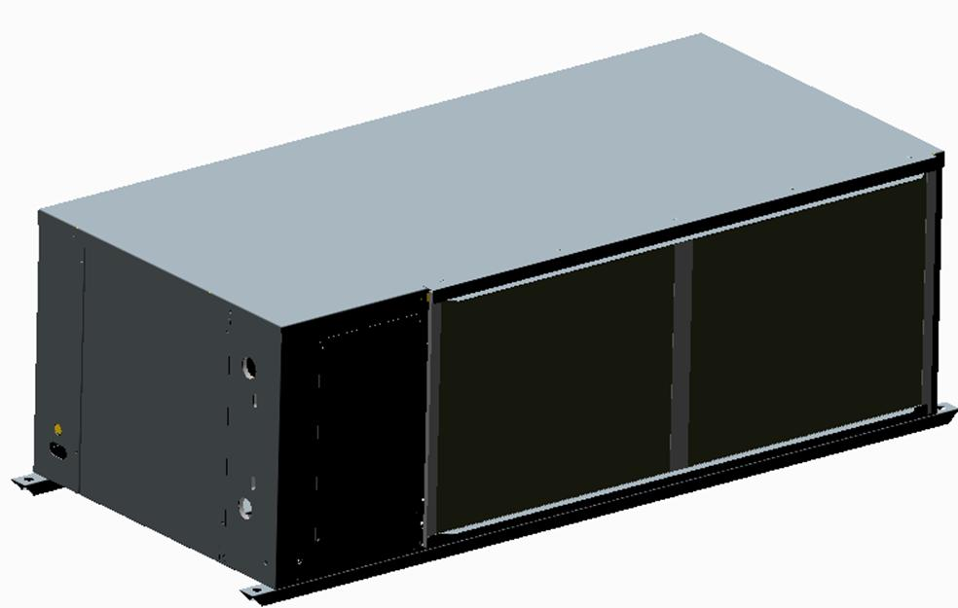
AQUALEAN – Technical Description
Cabinet:
Galvanised steel (not painted)
3 access panels to compressor area and electronic board for maintenance
Hanging device:
Unit can be easily connected to the ceiling thanks to hanging device.
Installer can use a threaded bar connected to the ceiling and fix the unit with nuts
Airflow configuration:
From factory: On the side (90°)
Size 007 to 015: In-line possible on site by turning the fan
Size 018 & 020: In-line possible on site by turning fan and by removing 2 sheet metal parts
Dimension:

Slide 6
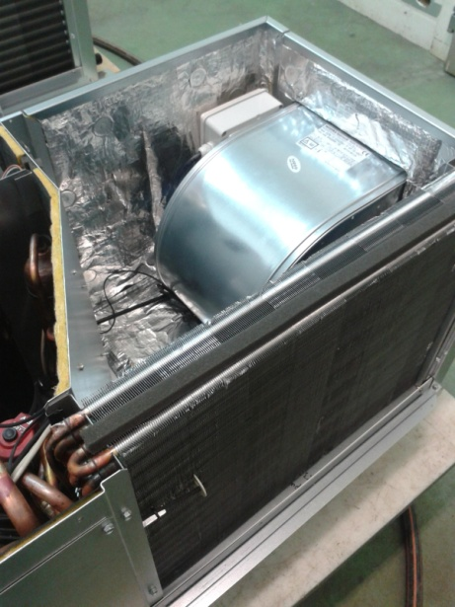
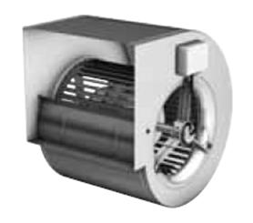
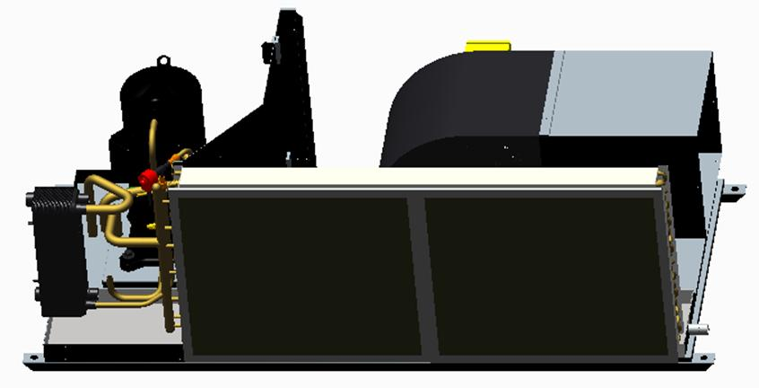
AQUALEAN – Technical Description
Supply fan:
Direct drive forward curved blades with variable speed supply fan.
Galvanized steel casing and blades.
(Size 002&003: plastic blades and casing)
Insulation:
25mm A2,s1,d0 / M0 insulation in air section
(Size 002&003: M1 insulation)
Thermal/acoustic insulation in compressor area
Condensate drain pan:
Large sloped drain pan with ¾” connection
Filter:
Washable G2 filter on rail
Water/Refrigerant Heat Exchanger:
Brazed Stainless Steel Plate Heat Exchanger
Optimized to reduce pressure drops (less than 50kPa)
(Size 002&003 : coaxial HE)
Air/Refrigerant Heat Exchanger:
Aluminium fins and copper tubes designed to provide the higher heat exchange.

Slide 7
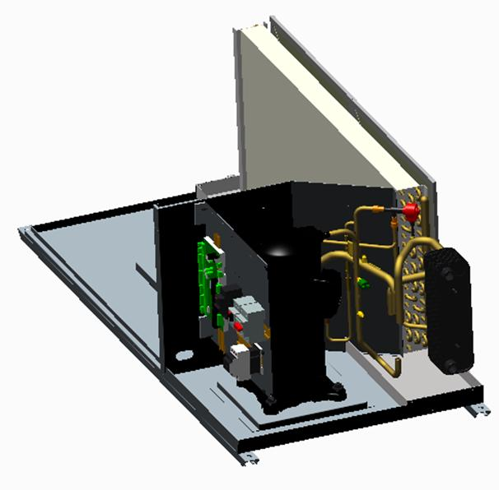
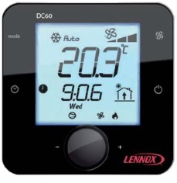
AQUALEAN – Technical Description
Compressor:
Scroll compressor with internal thermal protection and vibration absorbent blocks.
(Size 002&003 : Horizontal rotary compressor)
Thermodynamic circuit:
R410A refrigerant
Electronic Expansion Valve
4-way valve (for reversible units)
Copper tubes
Filter drier
Liquid receiver
Controler:
Climatic 60 controler
Master/slave up to 10 units
DC60 customer display with integrated thermostat to be
connected on site (optional for size 002&003)
ModBus/BACnet/Lonworks communication
Temperature sensor:
Supply air/Return air
Water inlet/Water outlet
Evaporating refrigerant (+Discharge refrigerant for size 002&003)
Low pressure transducer
High pressure switch
Condensate level sensor (size 002&003)

Slide 8
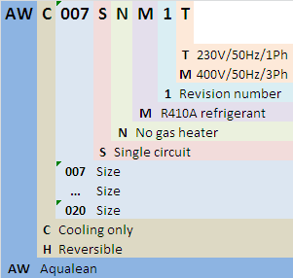
AQUALEAN - Article number explanation

Slide 9
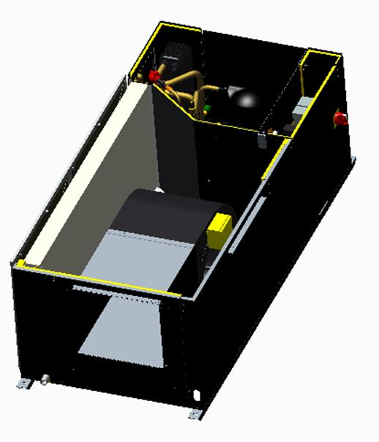
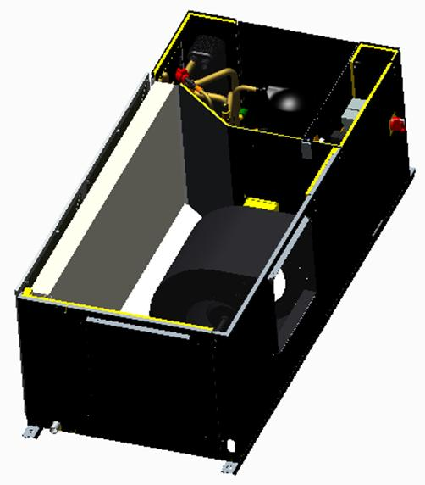
AQUALEAN – Airflow configuration
Supply airflow On the side (90°)
Units leave the factory with airflow configuration supply on the side of the unit (90° angle versus return).
Supply airflow In-line
The fan can be easily re-positionned, on site,
to have the supply outlet in-line.

Slide 10
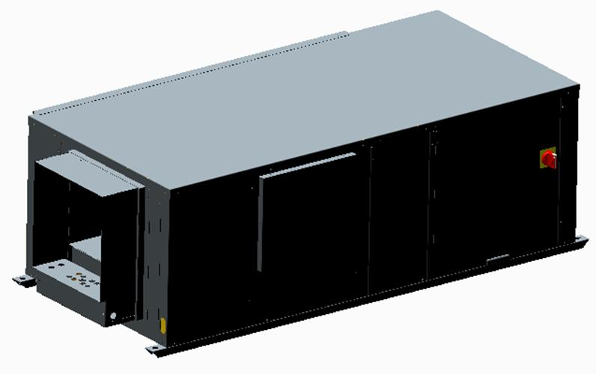
AQUALEAN – Heating options
Electrical heater
AQUALEAN | 002 | 003 | 007 | 008 | 010 | 012 | 015 | 018 | 020
Electrical Heater Small | - |  | 2 kW |  | 3 kW |  |  | 5 kW
Electrical Heater Medium | - |  | 5 KW |  |  |  |  | 9 kW
Electrical Heater High | - |  |  |  |  | 9 kW |  | 12 kW
Small electrical heater size complies with Spanish RITE regulation
(maximum 1,2x compressor capacity)
NOTE:
Only SMALL electrical heaters are available for REVERSIBLE units

Slide 11
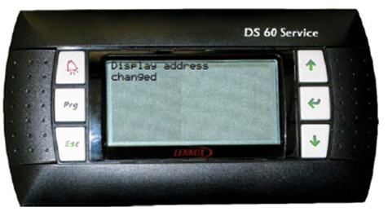
AQUALEAN – Control options
ModBus/BACnet/Lonworks interface
A communication interface can be added to the Climatic controler in order to communicate to a Building Management System.
Communication table are already loaded into the controler.
Available protocols: ModBus (RS485 or TCP/IP)
BACnet (RS485 or TCP/IP)
Lonworks (RS485)
DS60 Service display
This display provides access to the full controler menu to set all parameters.
Service Display

Slide 12
AQUALEAN – Safety & Electrical options
Main switch
Main disconnect switch is lockable to make a safe access to electrical panel. It is installed on the electrical panel door and control all parts.
It can also be used as an emergency cut off.
Compressor phase protection
Three phase protection located at the electrical box of the unit to ensure that the compressor will not operate if phases are connected wrongly.
Only available for 400V 3Ph 50Hz units.

Slide 13
AQUALEAN – Hydraulic options
Water filter
The water filter protects the unit against particles (greater than 1mm) getting inside the water circuit, and prevents the water heat exchanger getting dirty or clogging.
The water filter must be fitted in the water inlet of the unit. Increase pressure drops (see documentation for values).
Supplied loose.
Flow switch and water differential pressure transducer
The flow switch or the water differential pressure transducer stops the unit if water flow is lower than the minimum flow.
Automatic reset.
Supplied loose.

Slide 14
Options – Other options
Low noise
Compressor noise attenuation jacket.
Low water loop temperature (LWLT)
Addition of a 3-way valve and high pressure transducer to operate the unit below 15°C (down to 0°C).
The controler will monitor the 3-way valve (+VFC for the water pump).
The 3-way valve is supplied loose (pressure transducer factory mounted).

Slide 15
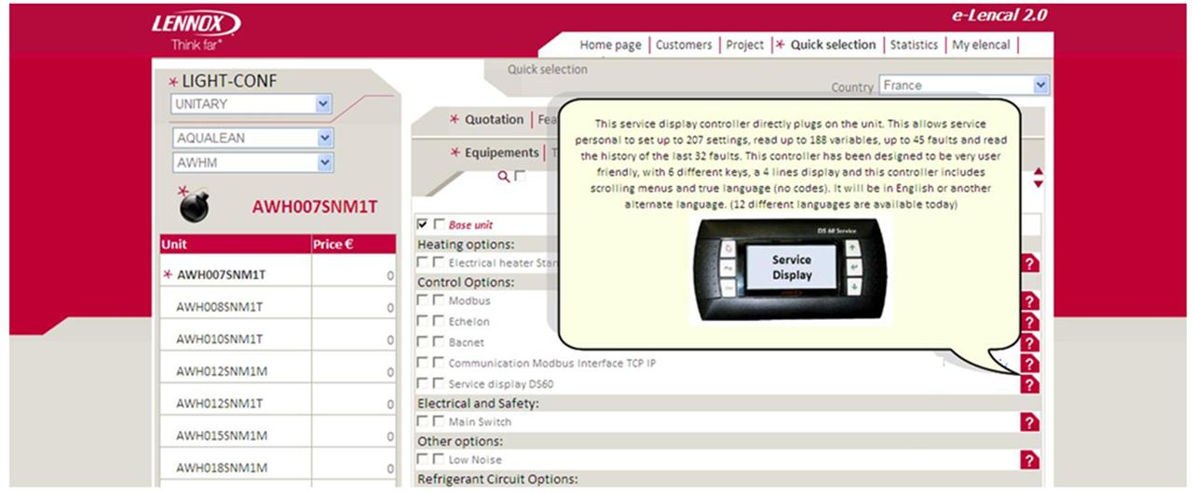
AQUALEAN – eLencal v2.0
AQUALEAN will be available for selection in the new eLencal v2.0
In Light Configuration.

Slide 16
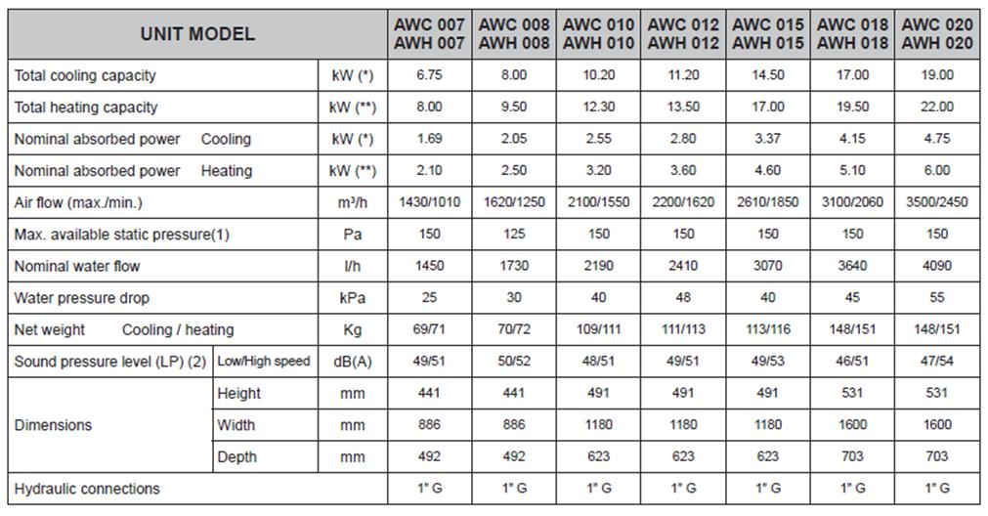
AQUALEAN – Technical details
* Air inlet: 27°C DB/19°C WB – Water Inlet 30°C
** Air inlet 20°C DB – Water inlet 20°C

