Slide 1
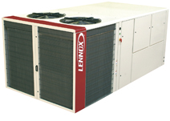
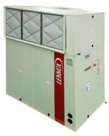
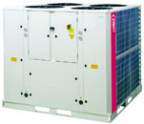
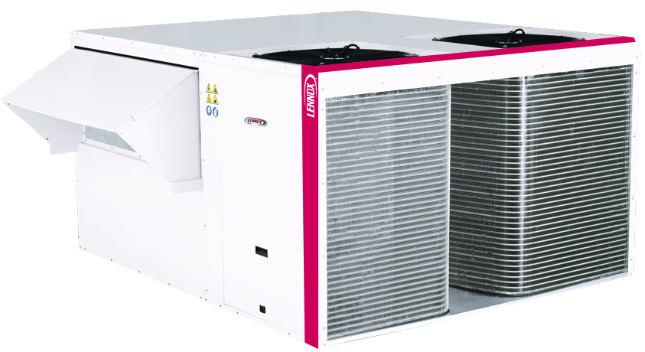

2010

Slide 2
ARMONIA
WATER CASSETTES

Slide 3
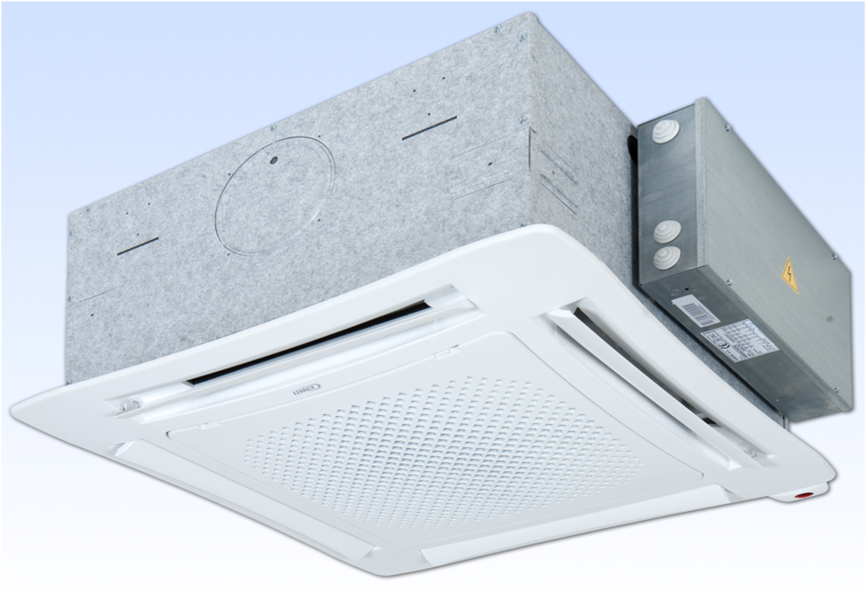

Slide 4
Range overview & configurations
Construction
Options
Key selling points & VS competition
Lennox sales tools

Slide 5
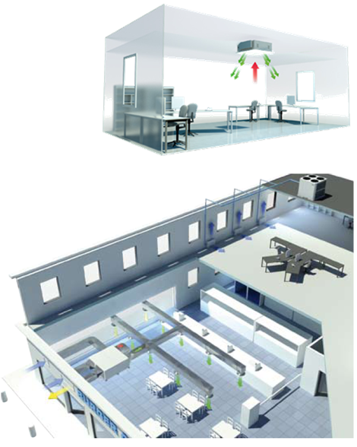
Range overview
A complete range of water cassettes
Air flow range: 300 – 1800 m3/h
Cooling capacities 1,3 – 11 kW
Typical Applications
  Light commercial buildings
  Offices
  Shops

Slide 6
Range overview
28 Models
AC motor
7 models 2 Pipes
5 models 4 Pipes
EC motor
5 models 2 Pipes
11 models 4 Pipes

Slide 7
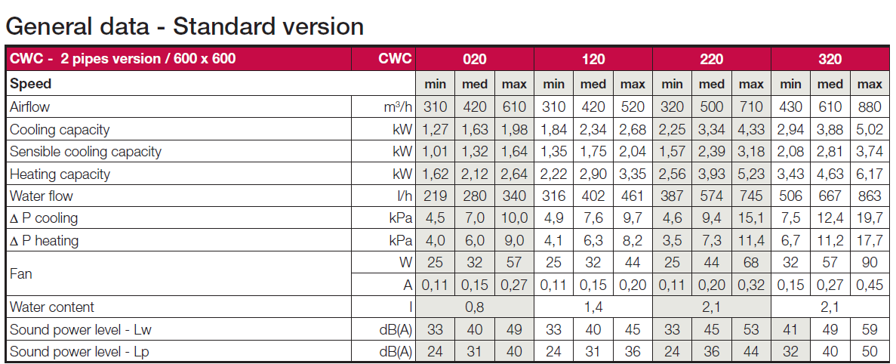
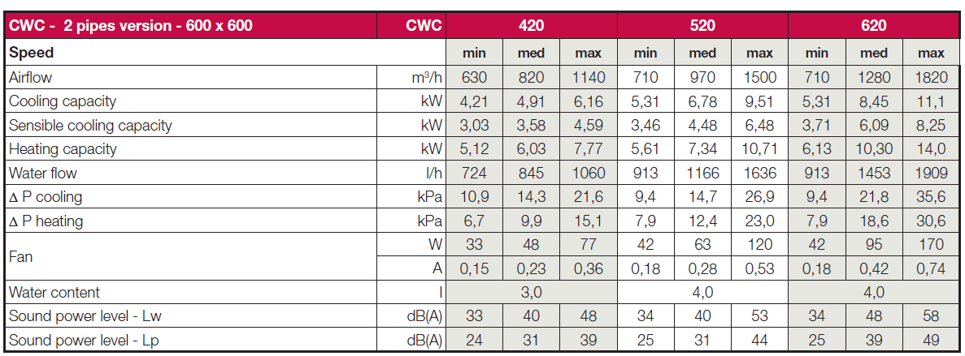
2 pipes - standard
800x800

Slide 8
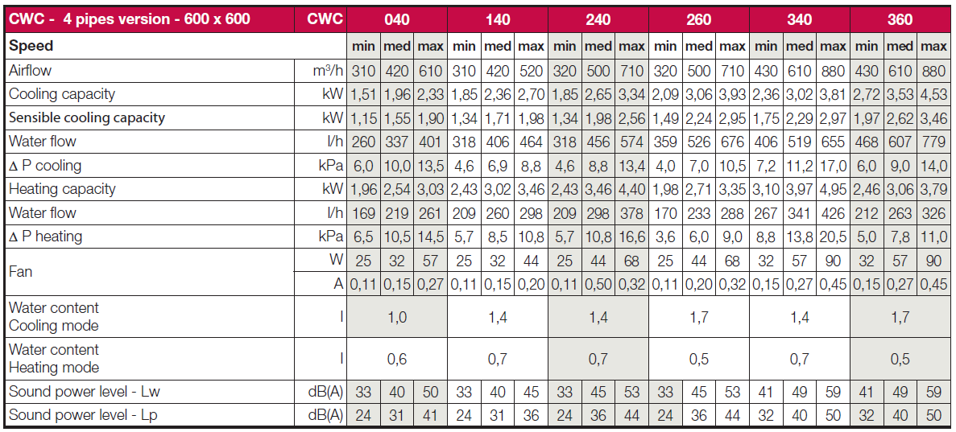
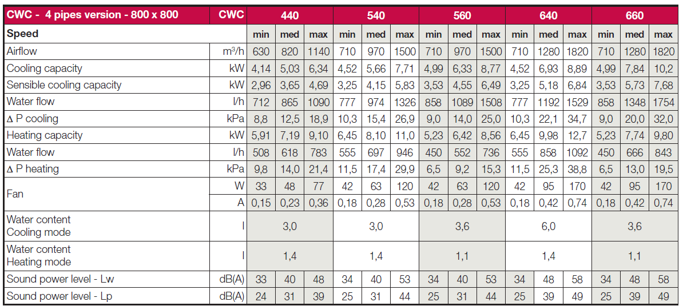
4 pipes - standard

Slide 9
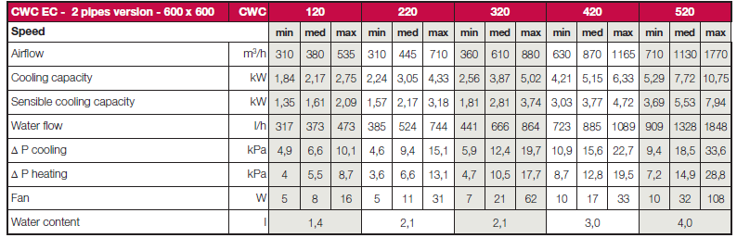
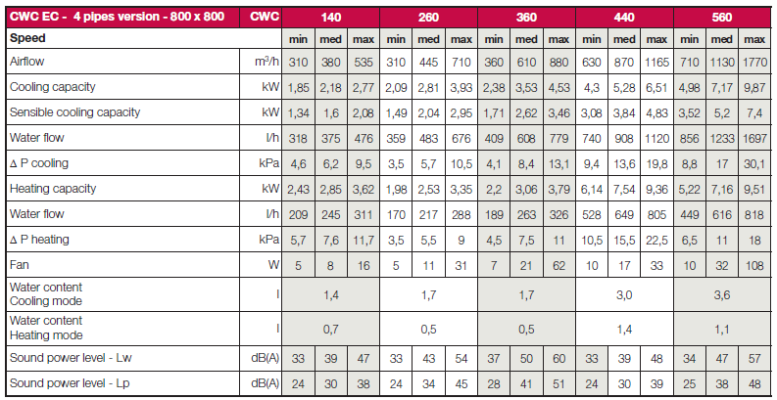
2 & 4 pipes – Ec fan

Slide 10
6 Configurations
ST Standard version
IR Infrared remote control version
EH Electric heater version
IR-EH Infrared remote control and
electric heater version
EC Ec fan version
EC-EL Ec fan version
with fitted electronic board for Ec fan

Slide 11
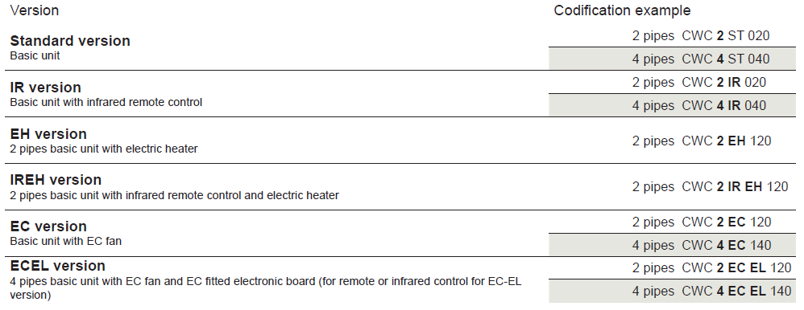
6 Configurations

Slide 12
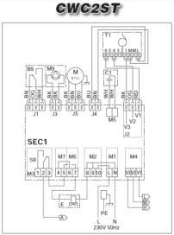
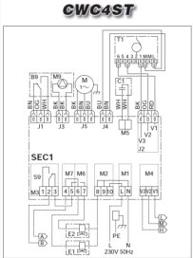
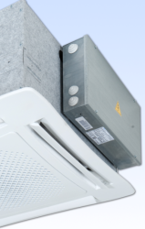


ST Standard version
Basic unit (2 or 4 pipe), AC motor, terminal board
to be connected with a stand alone remote control
Plastic or metallic diffuser possibility
Codification
-----------------------------------------------------------------------------------
2 pipes CWC2ST020/120/220/320/420/520/620
4 pipes CWC4ST040/140/240/260/340/360/440/540/560/640/660

Slide 13
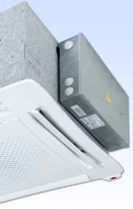

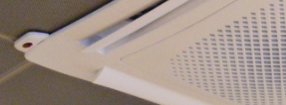
IR infrared remote control version
Basic unit (2 or 4 pipe), AC motor, on board IR card
Infrared remote control (and receiver)
Plastic or metallic diffuser possibility
Codification
-----------------------------------------------------------------------------------
2 pipes CWC2IR020/120/220/320/420/520/620
4 pipes CWC4IR040/140/240/260/340/360/440/540/560/640/660

Slide 14
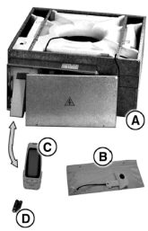

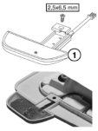

Infrared remote control
temperature set
fan speed switch or automatic speed selection
24 hours on/off program
on/off cooling or heating valve control for 2 or 4 pipe systems
control possibility: valves only or valves+fan
4 pipe systems automatic control with neutral zone
minimum water temperature function (2 pipe) to stop the fan when hot water is lower than 38°C (heating mode)

Slide 15
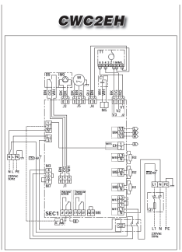
EH electric heater version
Basic unit (2 pipe) with electric heater, AC motor, terminal board to be connected with stand alone remote control
Plastic or metallic diffuser possibility
Codification
-----------------------------------------------------------------------------------
2 pipes CWC2EH120/220/320/420/520/620

Slide 16
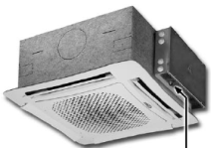

Electric heater
Electric heater is hermitically sealed, fitted inside the water coil.
Safety thermostat is standard supplied.
The electric heater can be used as:
heating element alone (only electric heater)
heating element as integration (water coil + electric heater)
with remote control RDF300.02 & LXRCC20
Model CWC120 CWC220-320 CWC420-520-620

Slide 17
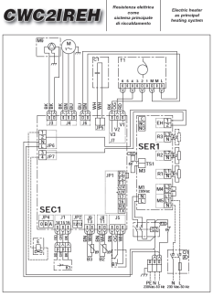



IR-EH Infrared remote control
and electric heater version
Basic unit (2P) with electric heater, AC motor, on board IR card
Infrared remote control (and receiver)
Plastic or metallic diffuser possibility
Codification
-----------------------------------------------------------------------------------
2 pipes CWC2IREH120/220/320/420/520/620
Warning!
Electric heater can’t be used as integration!!!!

Slide 18

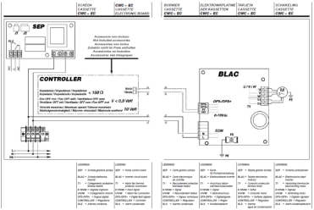
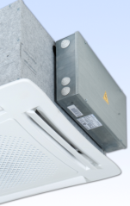
EC fan version
Basic unit (2 or 4 pipe), EC motor and inverter control. It has to be driven by an external control supplied by a third party.
Plastic or metallic diffuser possibility.
Codification e.g.
-----------------------------------------------------------------------------------
2 pipes CWC2EC120/220/320/420/520
4 pipe CWC4EC140/240/260/340/360/440/540/560
CLIENT CONTROLLER (0-10V)

Slide 19
Inverter characteristics – Input / Output
Power input
Applicable voltage value: 230Vac -10/+15% 50-60Hz +/-10%
In Rush Current Value: 25Apk
Input maximum power value: 115Watt
Input maximum current value: 1A
  Leakage current < 3,5 mA according to EN 60335
Signal input
0-10VDC
Impedence input: 470 kOhm
Voltage Swing applicable: 0-15Vdc
Lower voltage limitation: below 1 V the inverter stops the fan
External control requirements:
- 0-10 V dc output
- fan off for output < 0,9 V
- fan max speed for 10V
- output impedance < 100 Ohm

Slide 20
Fan speed: automatic speed variation 1-10V
Speed | Max RPM | Med RPM | Min RPM
Tension | 10V | 5V | 1V
CWC EC 120 | 730 | 540 | 390
CWC EC 220 | 940 | 635 | 390
CWC EC 320 | 1225 | 820 | 500
CWC EC 420 | 475 | 370 | 290
CWC EC 520 | 688 | 470 | 290

Slide 21
Relation between V_{input} and RMP
BLAC inverter controls the motor speed proportionally to the input voltage as per following relations
Vinput Range
1V → motor runs at rpm min.
10V → motor runs at rpm max.
Vinput range = 9V
Actual rpm = {[(rpm max. - rpm min.) / Vinput range] x (Vinput-1)} + rpm min.
Example based on CWC EC 320
1V → 500 rpm min.
10V → 1225 rpm max.
actual Vinput 5V
Actual rpm = {[(1225 - 500) / 9] x (5-1)} + 500 = 822,2 rpm

Slide 22

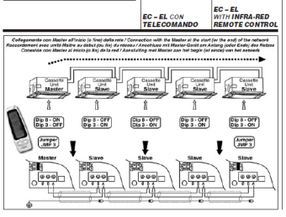
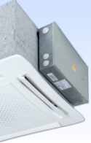
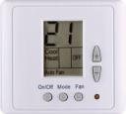
EC-EL Ec fan version
with fitted electronic board for Ec fan
Basic unit (2 or 4 pipe), EC motor, EC fitted electronic board
(for remote control ETN or infrared remote control RT03)
Plastic or metallic diffuser possibility
Codification
-----------------------------------------------------------------------------------
2 pipes CWC2ECEL120/220/320/420/520
4 pipes CWC4ECEL140/240/260/340/360/440/540/560
RT03
ETN

Slide 23
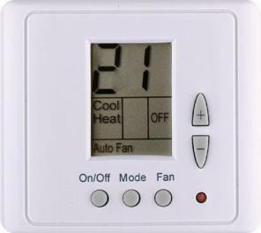
ETN remote control
ON/OFF control of the unit
Temperature set
Fan speed switch (low, med, high + automatic)
Automatic = fan continuously controlled
Mode set (cooling, heating, fan only, automatic)
Control of Cooling or/and heating valves for
2 and 4 pipe systems
Factory set of speed voltage
Input range adjustable on request

Slide 24
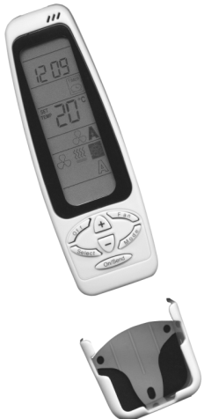
Infrared remote control RT03
Same functions as in IR version
but with 0-10V

Slide 25
Range overview & configurations
Construction & certification
Options
Key selling points & VS competition
Lennox sales tools

Slide 26
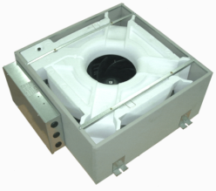
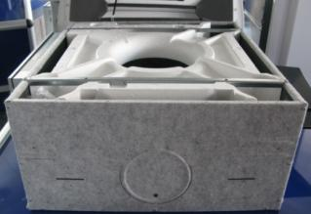
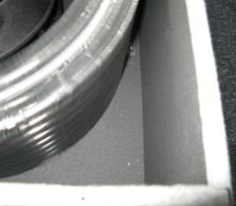
Casing
Galvanised steel
Thermal insulation (closed cell polyethylene,
10 mm thickness)
Outside anti-condensate lining

Slide 27
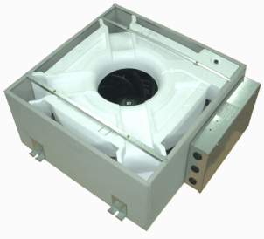
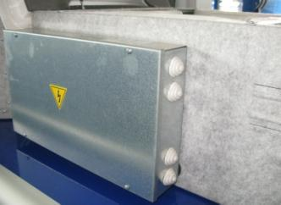
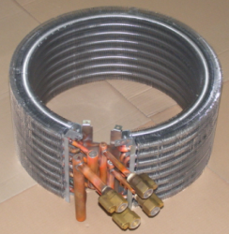
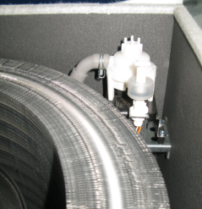
Control board and coil
CONTROL BOARD
External box with the control electronic board.
COIL
Copper tubes with bonded aluminium fins
1, 2 or 3 rows for 2 pipe models.
2+1 rows for 4 pipe models (heating row in the inside part of the cooling coil).

Slide 28
Configuration of coils
SIZE | NR OF RANGS
2 PIPES | COOLING / HEATING
CWC 0 20 | 1 R
CWC 120 | 2 R
CWC 220 | 3 R
CWC 320 | 3 R
CWC 420 | 2 R
CWC 520 | 3 R
CWC 620 | 3 R
4 PIPES | COOLING | HEATING
CWC 0 40 | 1 R | 1 R
CWC 140 | 2 R | 1 R
CWC 240 | 2 R | 1 R
CWC 260 | 2,5 R | 0,5 R
CWC 340 | 2 R | 1 R
CWC 360 | 2,5 R | 0,5 R
CWC 420 | 1 R | 1 R
CWC 540 | 2 R | 1 R
CWC 560 | 2,5 R | 0,5 R
CWC 640 | 2 R | 1 R
CWC 660 | 2,5 R | 0,5 R
IMPROVED
COOLING CAPACITY

Slide 29

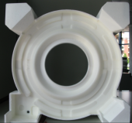
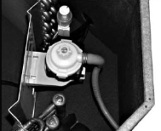
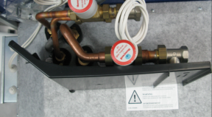
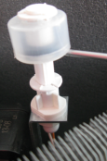

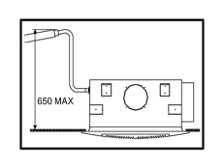
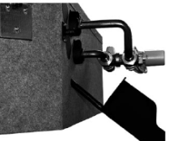
Condensate pans and pump
CONDENSATE PAN
High density ABS polystyrene foam,
shaped to optimize the air diffusion.
Fire retardant rating B2 to DIN4102.
AUXILIARY DRAIN PAN
ABS, standard supplied
CONDENSATE PUMP
Standard supplied
with floating switch
maximum head 650 mm

Slide 30
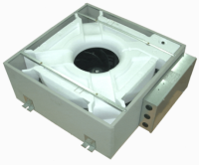
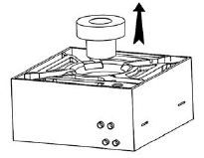
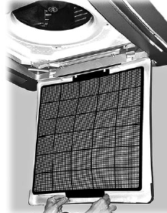
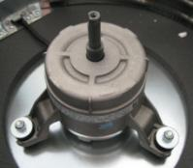
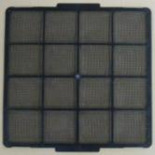
Fan Assembly & air filter
FAN ASSELBLY (AC motor)
Radial fan and fan group mounted on anti-vibrating supports
6 speeds electric motor, single phase 230V/50 Hz supply
Class B insulation, motor protection (integrated klixon thermal contact)
3 speeds wired as std. (changed on side when required)
Every unit is shipped with fan lock.
AIR FILTER
Synthetic washable filter

Slide 31
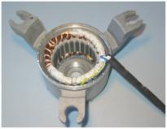
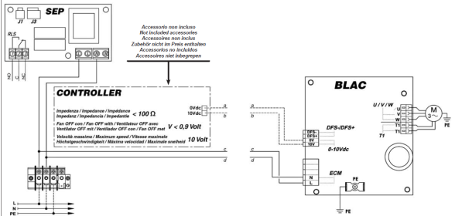

Ec fan assembly
Ec motor
Radial fan mounted on anti-vibrating supports
Brushless motor with permanent magnet technology.
Class B insulation, motor protection.
(integrated klixon thermal contact).

Slide 32



Air diffuser
Plastic diffuser: 600x600 or 800x800
Metallic diffuser: 600x600 (up to sizes 320/340/360)

Slide 33

Summer air throw adjustable air diffusion at 30° (manual)
Model 020-040-120-140 220-240-260 320-340-360 420-440 520-540-560 620-640-660
L throw refers to the distance between the unit and the point where the
air speed is 0.2 m/s.
Data are indicative and can change (room dimension..).

Slide 34


Winter air throw adjustable air diffusion at 45° (manual)
Model 020-040-120-140 220-240-260 320-340-360 420-440 520-540-560 620-640-660

Slide 35

600x600 dimensions

Slide 36

800x800 dimensions

Slide 37




Product certification
The units have been tested for the EMC and safety in
an indepent laboratory for the following standards:
  EN 55014-1/-2
  EN 61000-3-2/3
  EN 60335-1
  EN 60335-2-40
  EN 50366

Slide 38




CE Certification
Included in the Installation, operating and maintenance manual (standard and Ec version)

Slide 39


Eurovent Certification

Slide 40




Packaging
Packaging is resistant to avoid
damages during transport
and during on site movements.
600x600
6 units x pallet
+ 1 pallet with diff. / options
800x800
5 units x pallet
+ 1 pallet with diff. / options

Slide 41
Range overview & configurations
Construction & certification
Options
Key selling points & VS competition
Lennox sales tools

Slide 42


Fresh air supply and secondary air distribution
Inlets for fresh air to be mixed with return air.
Fresh air flow limited to 20% of the total air flow (medium speed)
100m3/h for each treated air inlet
Only 3 inlets available (1 for the pump)
Inlets are designed for 110x55 mm ducts
Secondary air distribution also possible
(pressure drops and air flows available in technical manual)

Slide 43


Fresh air management
Fresh air duct
(d.105 mm plastic connection)
Fresh air kit 1 way
(metallic duct & by-pass)

Slide 44



2 and 3 way valves – 2 & 4 pipes
Technical data
Valves characteristics

Slide 45



MSC – master slave card
(up to 8 units with 1 remote control)
Warning ! Remote control output must support total absorbed current of actuators

Slide 46

Digital area manager
Up to 60 Armonia water cassettes (only with IR and EHIR version)
Used to manage up to 60 Armonia cassettes from one single control point.
The control communicates via a serial line with all the units, with the possibility of controlling them all together or individually.
Functions:
display operating mode, fan speed and
set point
display room temperature measured on
the individual unit
turn all the units on or off at the same
time or alternatively each unit individually
change the operating mode (fan only,
heating, cooling, automatic changeover)
change the set point
Each function can be sent to all units connected, or alternatively to each individual unit.
Different set points or operating modes can be set for each individual unit.
The control panel can also be used for 1 week program (2 ON times & 2 OFF times
for each day of the week).

