Slide 1
ALLEGRA – ARMONIA
Modbus control
Olivier Lenglet
Airside/CCU Product Manager
Olivier LENGLET – the 3rd of February 2013

Slide 2
INTRODUCTION OF NEW CONTROL
This presentation explain our new offer of control fitted on our fancoil ranges ALLEGRA and ARMONIA.
This version includes
  Infra-red remote control
  Master/Slave logic (up to 20 units)
  BMS - Modbus RTU - RS 485 communication protocol.
  9600bit/rate – 1 bit/parity – 1 bit stop
  All detail around ModBus communication – Parameter List
The system consists in a Modbus power board mounted on the units, and a series of remote control, such as the RDC65 wall mounted, the RIR65 infra-red, the RDM65 multifunction remote control

Slide 3
What the MB Cards are?
Three cards:
  One for the ALLEGRA range
  One for the ARMONIA AC motor
  One for the ARMONIA EC motor
Functions
  Basically the MB cards are similar to the current IR version
  The main difference is the protocol used for the communication:
  It was proprietary protocol for the IR series now it is Modbus for the MB series
Note
  2 sensors are included with this option :
T1 = return air probe
    T3 = minimum coil temperature probe

Slide 4
What the MB Cards are?
Compared with the IR Cards, the new ones are:
  Dimensionally the same of the IR version.
  The electrical connections the same too
The only differences are on the receiver and the receiver cable connection. The new one uses a 4 wires connection instead of the 3 of the current one.
IMPROVEMENTS
Filters section of the receiver card have been improved
Filters on the serial section of the Card have been improved
Additional filters on the digital input have been added
Double terminal block to connect the serial connection cables (RS485 inlet and outlet line)
The working possibilities and electric heater managing have been improved.

Slide 5
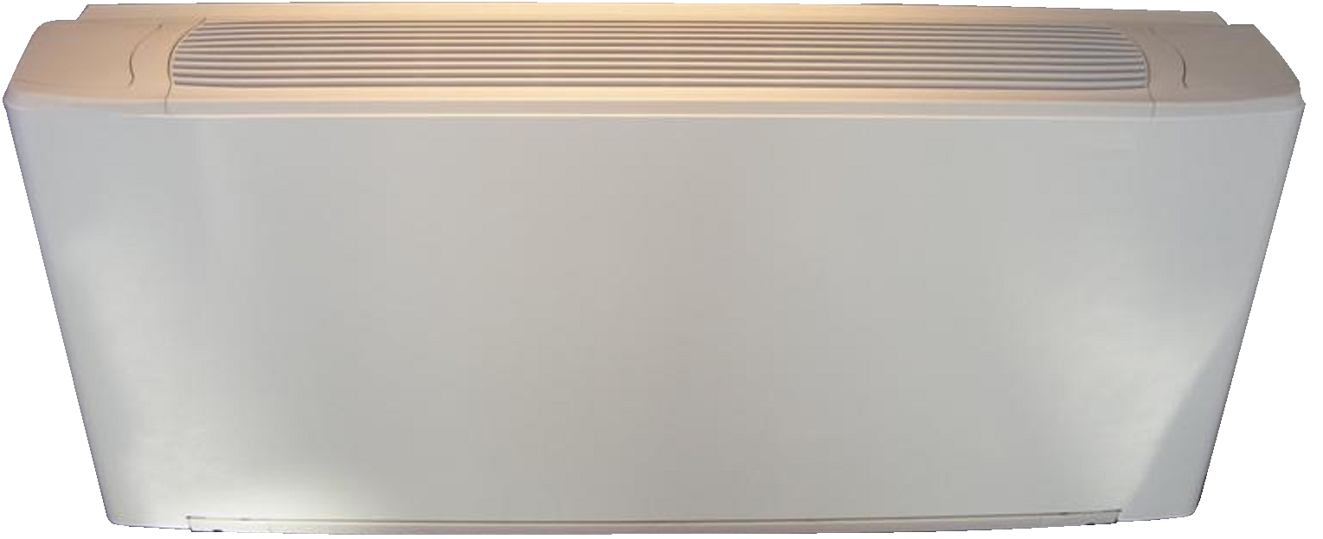
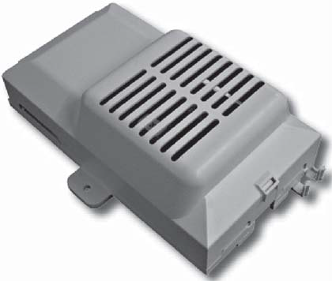
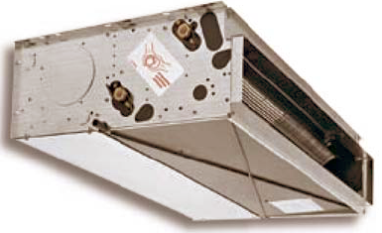
APPLICATION WITH ALLEGRA
For ALLEGRA range the Modbus card is fitted on the unit
But has to be selected as an option.
Former code New code
9066326 9066332

Slide 6
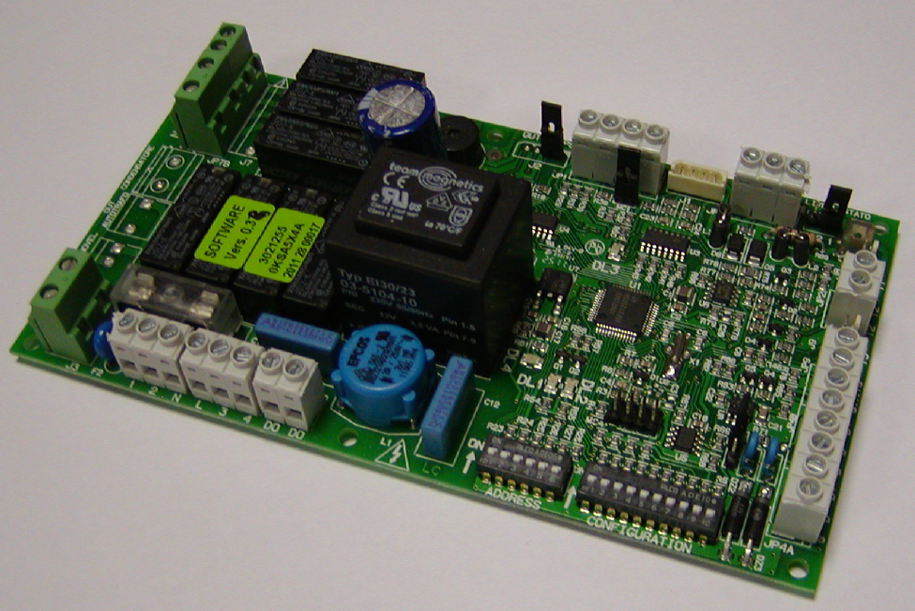
APPLICATION WITH ALLEGRA

Slide 7
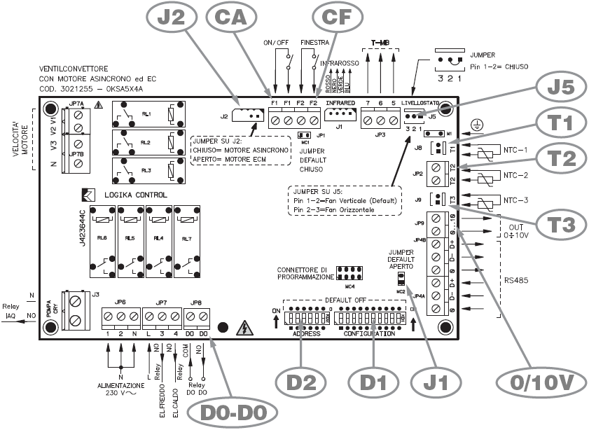
APPLICATION WITH ALLEGRA
D1 = configuration dip switches
D2 = address dip switches
J1 = jumper MC2
T1 = air probe
T2 = water probe (for auto CH or electrical heater
T3 = minimum coil temperature probe
CF = F2-F2 windows contact
CA = F1-F1 contact (remote On/off or CH)
J5 = vertical / horizontal fan-coil installation
J2 = asynchronous / EC motor switch
0/10V = EC inverter control
D0-D0 = free contact

Slide 8
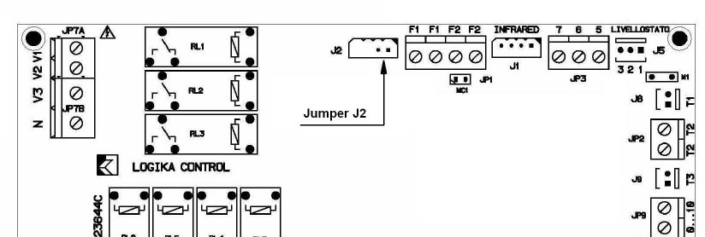
APPLICATION WITH ALLEGRA
One Control Card is used to cover the range of fan coil with asynchronous and EC brushless motors
To set the motor type you have just to move the jumper J2
  J2 Closed = Asynchronous motor
  J2 Open = EC Motor

Slide 9
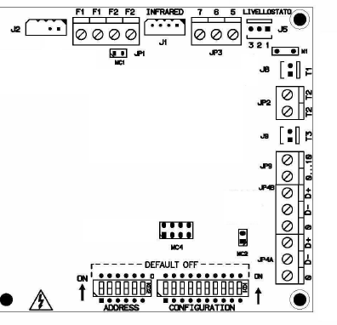
APPLICATION WITH ALLEGRA
JUMPERS
J2 – Asyn / Ecm
J5 – Vertical / Horizontal
(destratification function in horizontal)
JP 1 – Windows contact
(remove when F2-F2 used)
MC 2 – END of the serial line connection
J 2
J 5
JP 1
MC2

Slide 10
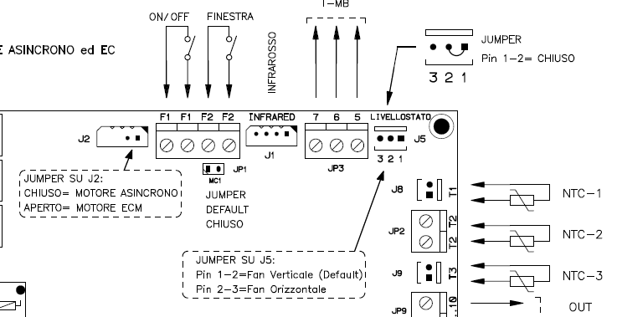
APPLICATION WITH ALLEGRA
On the PCB we have 2 different Jumpers:
  J2: defines the motor type, asynchronous or brushless
  J5: defines the fan-coil installation type in order to prevent stratification problems. Even if the fan is paused, the control makes the fan running every 15 minutes
    Vertical installation: the fan cycle operates in cooling mode in summer. In cooling mode we also have a 2 min fan at the control power on
    Horizontal installation: the fan cycle operates in heating mode in winter

Slide 11
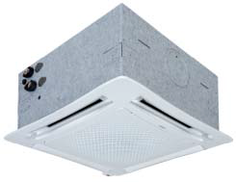
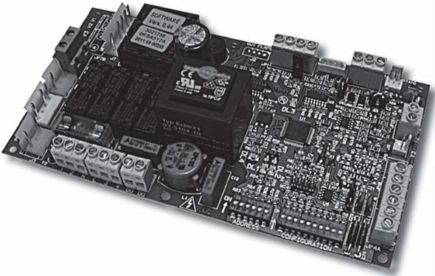
APPLICATION WITH ARMONIA
For ARMONIA range the Modbus card is fitted on the unit
and included in the unit MB version (code with MB).
The remote control is no longer include
The code of the ARMONIA is modified
Former code New code
CWC2 IR xxx CWC2 MB xxx
CWC4 IR xxx CWC4 MB xxx
CWC2 IREH xxx CWC2 MBEH xxx
CWC2 ECEL xxx CWC2 ECMB xxx
CWC4 ECEL xxx CWC4 ECMB xxx
Introduction of a new ARMONIA version :
EC-motor + Electrical heater CWC2 ECMBEH xxx

Slide 12
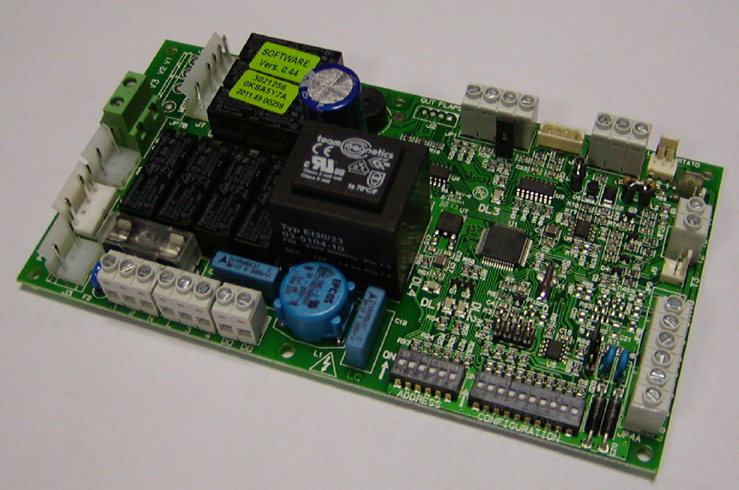
APPLICATION WITH ARMONIA AC motor

Slide 13
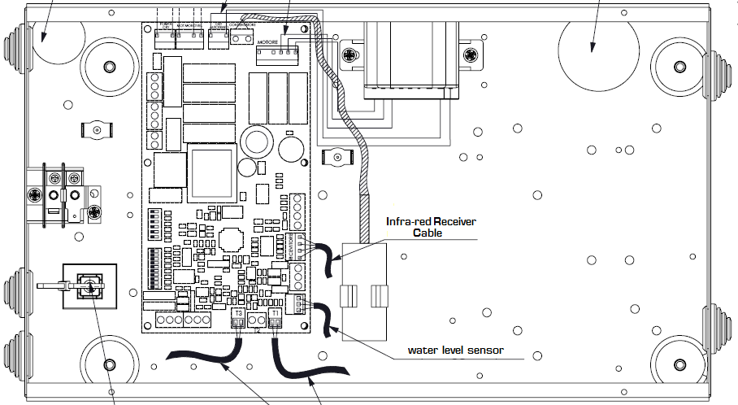
APPLICATION WITH ARMONIA AC motor

Slide 14
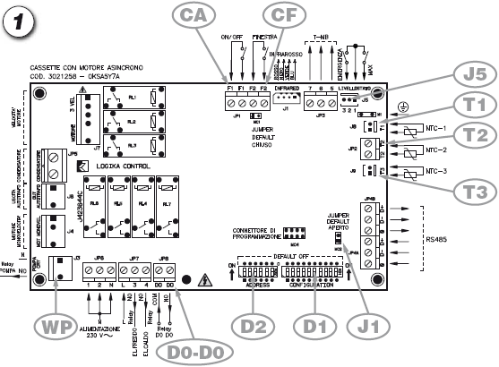
APPLICATION WITH ARMONIA AC motor
D1 = configuration dip switches
D2 = address dip switches
J1 = jumper MC2
T1 = air probe
T2 = water probe (for auto CH or electric heater
WP = water pump
T3 = minimum coil temperature probe
CF = F2-F2 windows contact
CA = F1-F1 contact (remote On/off or CH)
J5 = water level sensor
D0-D0 = free contact

Slide 15
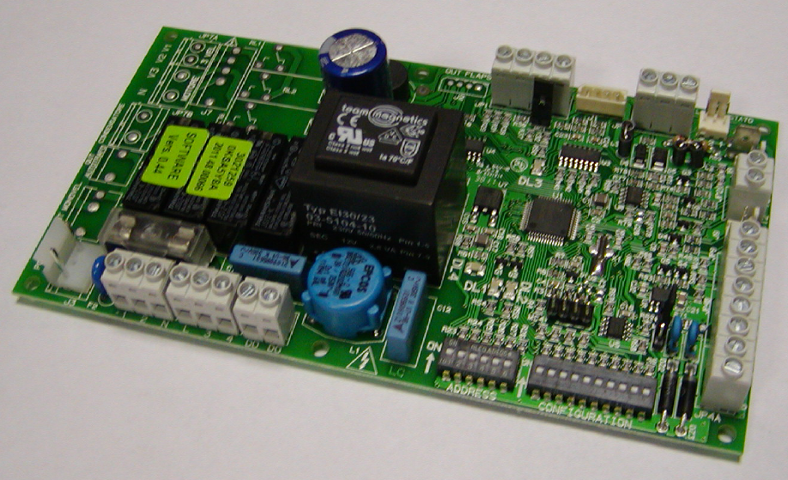
APPLICATION WITH ARMONIA EC motor

Slide 16
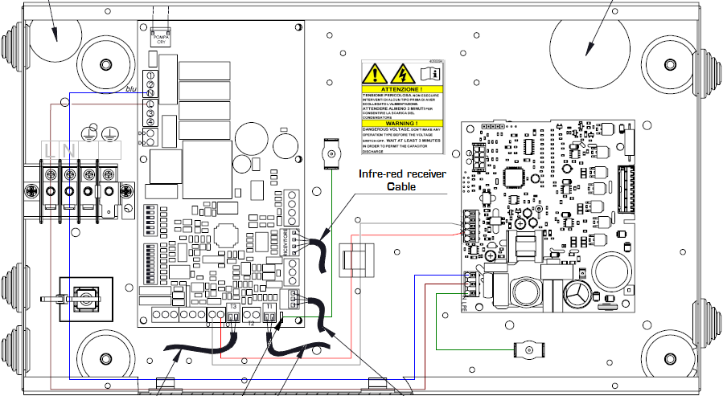
APPLICATION WITH ARMONIA EC motor

Slide 17
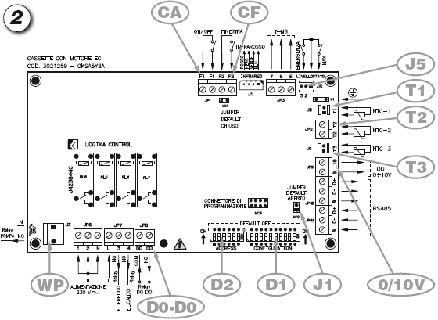
APPLICATION WITH ARMONIA EC motor
D1 = configuration dipswitches
D2 = Address dipswitches
J1 = Jumper MC2
T1 = Air probe
T2 = water probe (for auto CH or electric heater
WP = water pump
T3 = minimum coil temperature probe
CF = F2-F2 windows contact
CA = F1-F1 contact (remote On/off or CH)
J5 = water level sensor
0/10V = EC inverter control
D0-D0 = free contact

Slide 18
APPLICATION WITH ARMONIA
JUMPERS
JP 1 – Windows contact (remove when F2-F2 used)
MC 2 – END of the serial line connection
JP 1
MC2

Slide 19
ELECTRONIC BOARD FITTED
Functions and adjustment modes
Modes are selected by setting
the configuration dip switches on the board.
2/4 pipe system.
Electric heater control
Fan ON/OFF thermostatic control.
Valve ON/OFF thermostatic control and continuous ventilation.
Valve and simultaneous ventilation ON/OFF thermostatic control.
Fan operation control depending on the coil temperature against low water temperature in heating mode or heating and cooling mode.
Automatic change over with water probe (optional for 2 pipe system.)
Change over by remote contact.
ON/OFF by remote contact (window or clock contact).

Slide 20
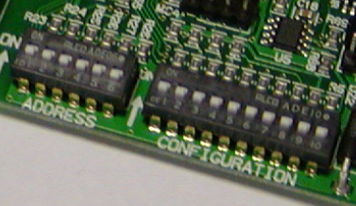
Dip Blocks
Address Dip Block.
  6 Dip that means it is possible to address up to 63 units with different AD number
Configuration Dip Block
Address Dip Block
6 Dip Max 63 addresses
Configuration
Dip Block

Slide 21
Configuration Dip Block
Dip | On Dip Position | OFF Dip Position (default)
n°1 | 4 Pipes Units | 2 Pipes Unit
n°2 | Thermostatic control on the Fan | Thermostatic control on the Valves
n°3 | T3 enabled | T3 Disable
n°4 | T3 enabled in summer and winter | T3 enabled in winter only
n°5 | Simultaneous Fan and Valves control | Continuously fan operation
n°6 | Electric heater installed | ---------
n°7 | Electric heater controlled under T2 | T2 as change over CH (Electric heater controlled as 2nd stage)
n°8 | D0-D0 combined with the water pump alarm (Cassette only) | D0-D0 combined with the unit status (On-Off)
n°9 | IN1 = Winter/Summer remote change mode | IN1 = On / Off remote control
n°10 | Slave | Master

Slide 22
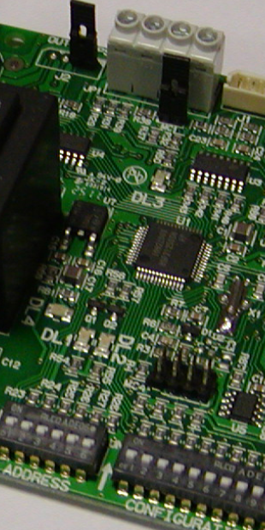
Status and Alarms Leds Indication
DL 3
 | LED1 |  |  | LED2 |  |  |  | LED3
 | ON | Blink | OFF | OFF | ON | Blink | 4+2 | OFF | ON | Blink | 4+2 (*)
RX 485 | KO | OK
T1 |  |  | OK | OK |  | KO | KO
T3 |  |  | OK | OK | KO |  | KO
IN2 |  |  |  |  |  |  |  | OK |  | Open | Open
IN1 |  |  |  |  |  |  |  | OK | Open |  | Open
DL 1
Broadcast, probes , IN1 and IN2 indication
(*) 4+2 = 4 s light fix + 2 s blinking
DL 2

Slide 23
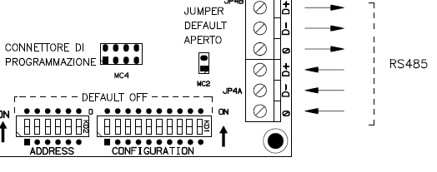
Serial Bus connection
The PCB has a double terminal block in order to make the RS485 wiring easer
The RS485 shield must be connected to the “0” terminal block. The shield must be connected to the PCB only and not grounded with the earth.

Slide 24
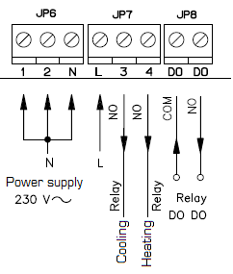
D0-D0 dry contact
Allows the remote monitoring of the unit
  Open contact – the unit is in OFF condition
  Closed contact – the unit is in ON condition
Allows the remote monitoring of the condensate water pump status
  Open contact – pump normally working
  Closed contact – pump alarm
Mode selected by Dip n°8

Slide 25
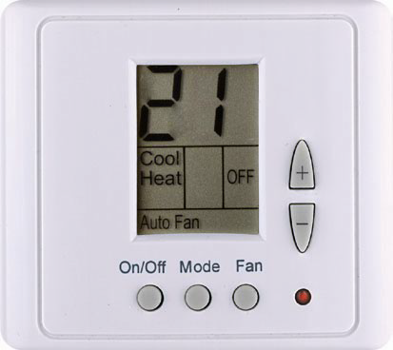
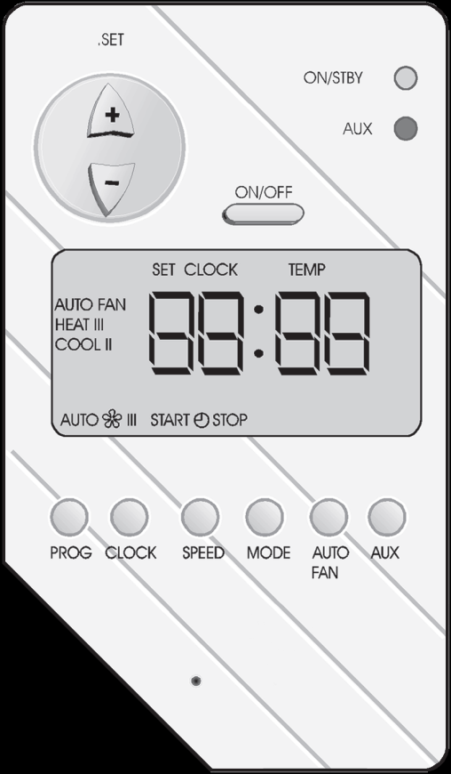
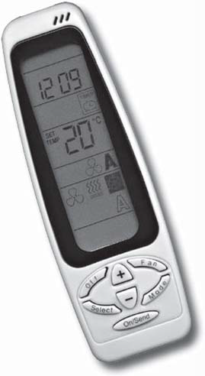
NEW REMOTE CONTROL
This new control will replace
Remote control ETN
Digital area manage
Infrared remote control RT03

Slide 26
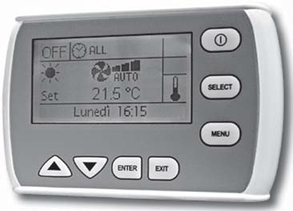
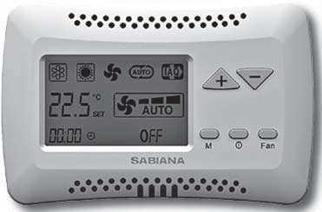
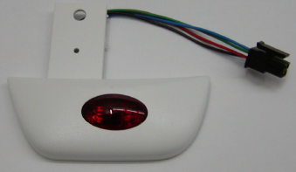
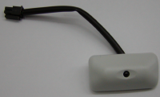
REMOTE CONTROLLERS
RDM65
multifunction remote control
RIR65
infra-red
remote control
ARMONIA
Receiver
ALLEGRA Receiver
RDC65
wall mounted control

Slide 27
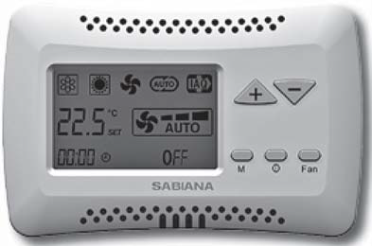
RDC65 – Remote wall mounted display
Allows controlling one or up to 20 units in Master/Slave mode.
The control is equipped with internal room sensor
(can be defined as a priority compared to the return air sensor of the unit)
Functions:
Switch the appliance ON and OFF.
Temperature set.
Modify the set point (when used as a +/- 3°K).
Set the fan speed (low, medium, high or autofan).
Set the operation mode (fan only, cooling, heating; auto for 4 pipe systems
with mode selection depending on the air temperature).
Time setting.
Weekly ON/OFF program (one switch on/off per day)
View of unit status and alarm
Display and change of the fan coil operation parameters.
Code 9066331E

Slide 28
RDC65 – Remote wall mounted display
Here is the parameters list that can be modified by the RDC65 control:
  Thermostat differential
  Offset of the internal sensor (sensor calibration)
  Dead zone for the 4 pipes
  Set point limits
  T3 working temperatures
  T2 change over temperatures
  Cassette condensate pump working cycle
  Setting range for the +/- 3° application
  Inverter working parameters

Slide 29
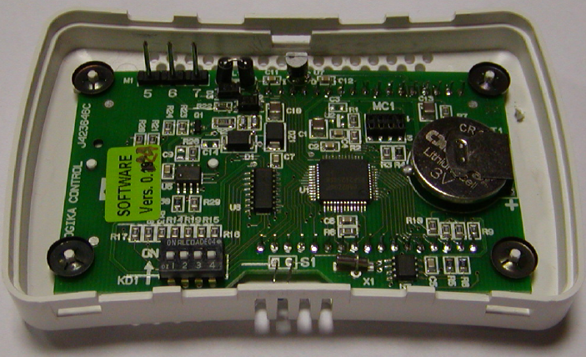
RDC65 – Remote wall mounted display

Slide 30
RDC65 – Remote wall mounted display
Dip | Positon = OFF | Position = ON
n°1 | T-MB | T-MB ± 3°C
n°2 | NTC internal sensor enabled | Remote fan-coil sensor enabled (T1)
n°3 | Not used
n°4 | Not used
On the RDC65 card we have a Dip switch block useful to set some functionality mode:
  You can choose to have the control as a room thermostat or as a +/- X°C potenziometer
  You can choose to use the sensor control or the remote T1 probe

Slide 31
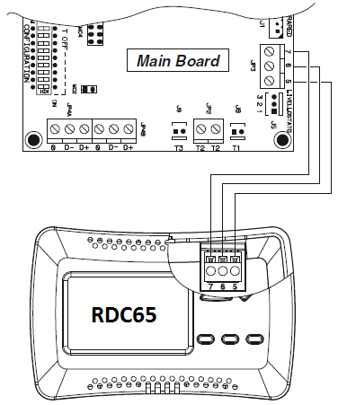
RDC65 – Remote wall mounted display
Use 3 x conductors with 0.5 mm2 section
NOTE: The connection wirings must not exceed 20m

Slide 32

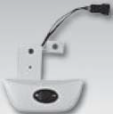


RIR65 – infra-red remote control
Allows controlling one or up to 20 units in Master/Slaves mode.
(in master/slaves only the master has to be equipped with receiver)
Functions:
Switch the appliance ON and OFF.
Temperature set.
Set the fan speed (low, medium, high or autofan).
Set the operation mode
(fan only, cooling, heating; auto for 4 pipe systems with mode
selection depending on the air temperature).
Time setting.
24 hours on/off program
on/off cooling valve control
on/off heating valve control.
Control of the valves only or of the valves and the fan together
Valve control of 2 or 4 pipe systems with winter/summer switch on the infra-red control.
Valve control of 4 pipe systems with automatic heating/cooling mode selection with 2°C dead zone
Activating the T2/T3 sensor connected to the T3 contact of the board (non active in the standard configuration)
Code 3021203
Code 9079116
Code 9079117

Slide 33
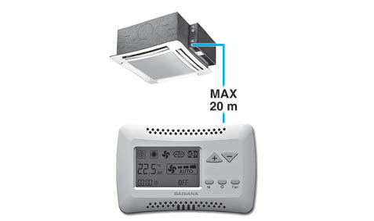
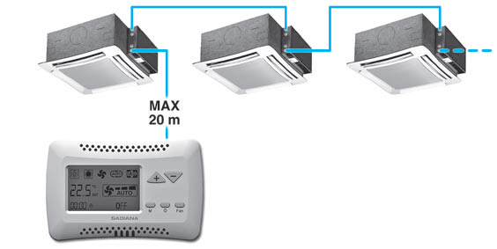
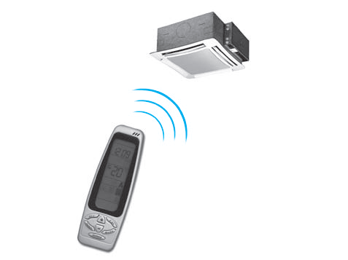
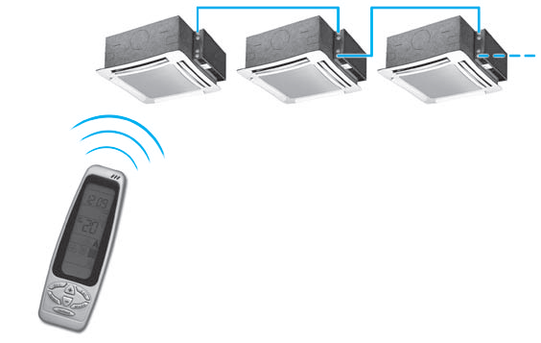
Master / Slaves
Allows controlling one or up to 20 units in Master/Slaves mode.
(20 units max.)
(Maximum total length of the connection cable = 800 m)

Slide 34
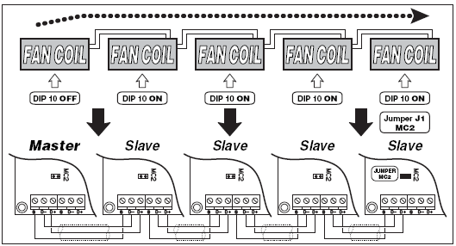
Master / Slaves
Any fan coil can be controlled as a stand alone unit or connected as Master/Slave group
Master is the unit where the receiver is installed or the RDC65 is connected
It is possible to connect up to 20 units

Slide 35
Master / Slaves
Temperature control on a Master/Slave network
All the units are set at the same working condition transmitted by the RIR65 or RDC65 remote control
Using an RIR65 remote control, each connected unit works in accordance to the air temperature measured on the air intake (T1 probe)
Using a RDC65 wall mounted control, it is possible to choose whether to use the T1 probe installed on each unit or the ambient temperature measured by the sensor that is in the control

Slide 36
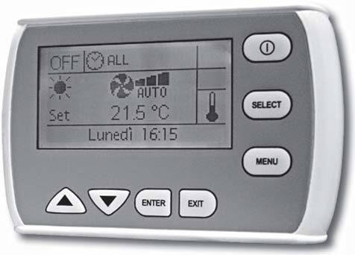
RDM65 – multifunction remote control
Code 3021293
Possibility to manage up to 60 Cassette units
(the maximum length of the RS 485 connection cable
must not exceed 800 m)
Can be used to set the operating mode.
Display the operating conditions of each
individual unit.
Can be used to set the ON/OFF time sets for each day of the week
(the program can be set for all the units or for a maximum of two groups
of units).

Slide 37
RDM65 – multifunction remote control
Communicates via a serial line with all the units connected, with the possibility of controlling them all together or individually.
In fact, the unique address of each individual fan coil means that all the units can be called at the same time, or the individual unit called, to perform the following functions:
Display the current operating mode, the fan speed, the set point.
Display the room temperature measured on the individual unit.
Turn all the units ON and OFF at the same time or alternatively each unit individually.
Change the operating mode (fan only, heating, cooling, automatic changeover).
Change the set point.
Modify the values and operation parameters of the fan speed.
Each function can then be sent to all the units connected, or alternatively to each individual unit.
Different set points or operating modes can be set for each individual unit.
Time management of the units over the week. Two ON times and two OFF times can be set on the units for each day of the week.
The weekly programming mode can be stopped at any time, returning to the manual setting and then weekly programming mode can subsequently be started again.

Slide 38
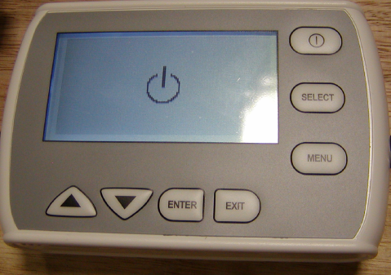
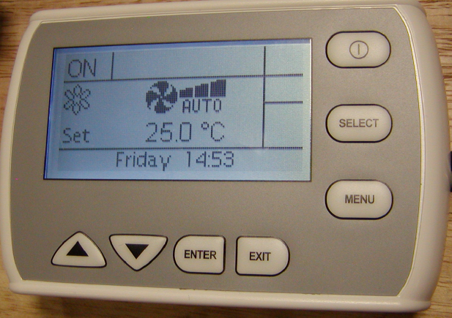
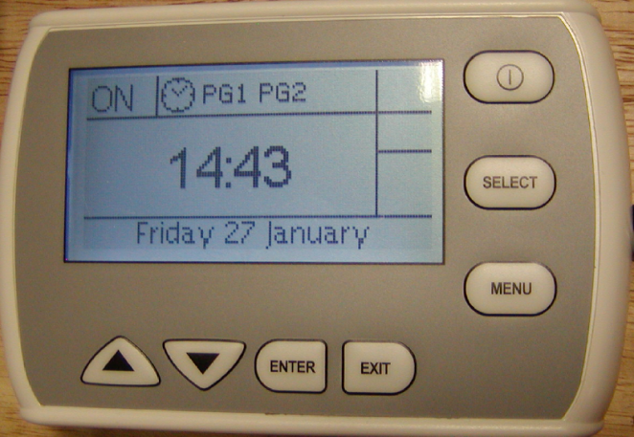
RDM65 – multifunction remote control
The display view changes depending on how the units are set
Switch Off of the control
All the units have the same parameters
The units have different parameters

Slide 39
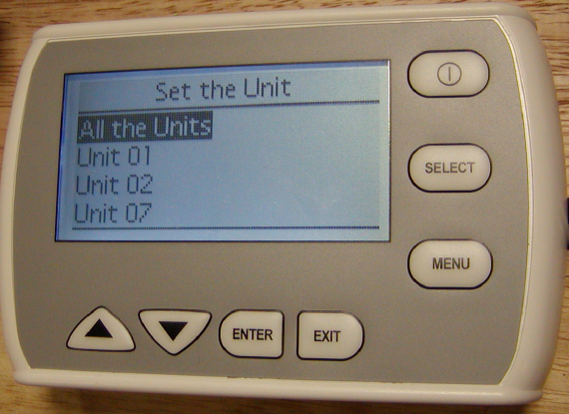
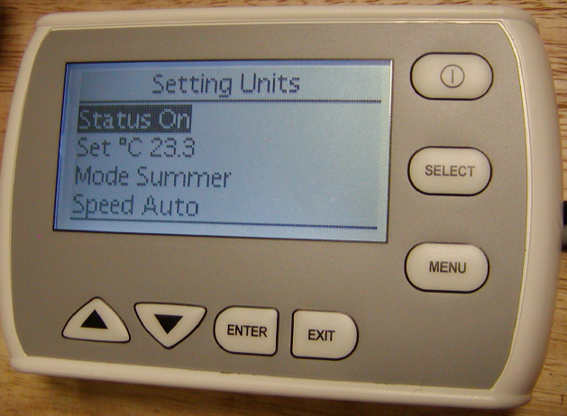
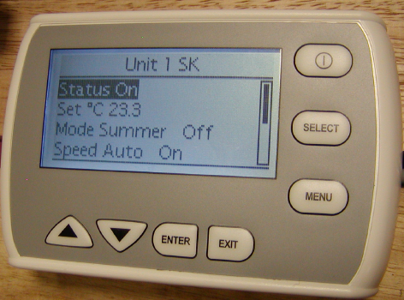
RDM65 – multifunction remote control
It’s possible to set the same working parameters
for all the units or to set unit per unit in different ways

Slide 40
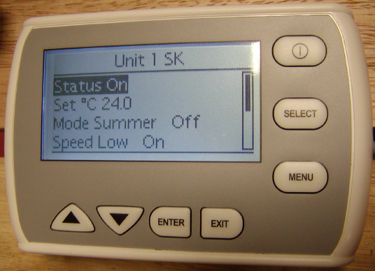
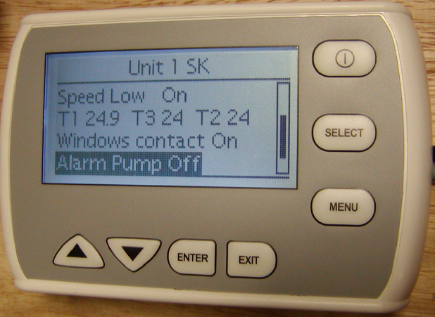
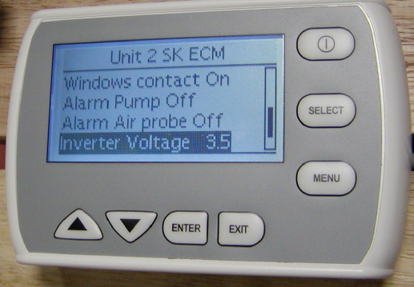
RDM65 – multifunction remote control
It’s possible to view the working functions for any connected unit
If the unit has an EC motor, it’s possible to see also the inverter working tension

Slide 41
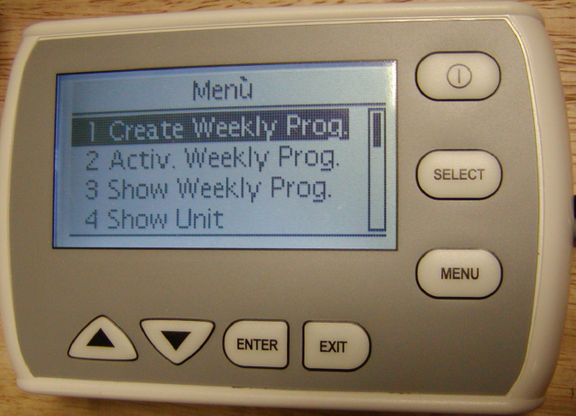
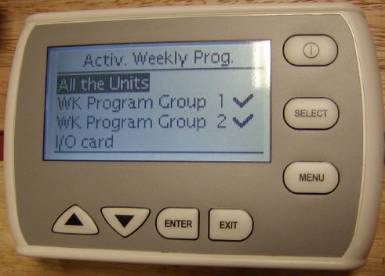
RDM65 – multifunction remote control
It’s possible to create a weekly program for all the units or to create up to two different groups of units, for each of them a weekly program can be set
The created weekly programs can be activated or deactivated

Slide 42
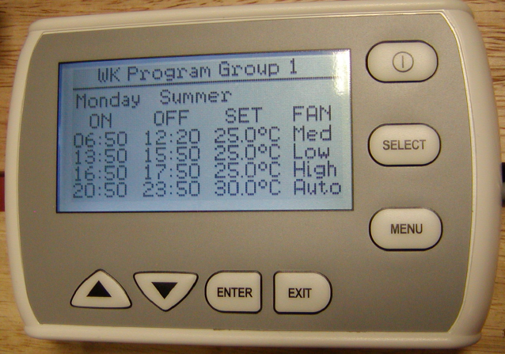
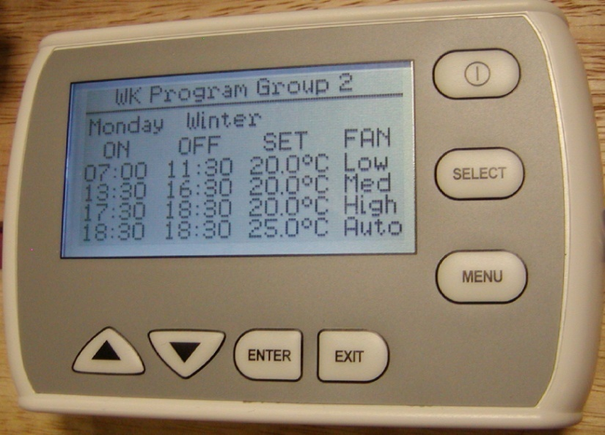

RDM65 – multifunction remote control
Weekly Program:
It is possible to have one weekly program for all the units
Two different WP for two groups have been created
It is possible to create a WP also for an I/O Card

Slide 43


RDM65 – multifunction remote control
It’s possible to set the working parameters for all the units at the same time

Slide 44




RDM65 – multifunction remote control
Or it’s possible to set the working parameters unit per unit
The parameters are:
Set limits
T3 probe temperatures
Hysteresis, Dead zone
Inverter values
Pump cycling (Cassette only)

Slide 45

RDM65 – multifunction remote control
A group of fan-coil units can be connected via a serial link and can consequently be managed with just one wall-mounted intelligent controller RDS65. The wall-mounted controller can be used to set the operating mode for each individual unit connected, display the operating conditions of each individual unit, and set the on/off time bands for each day of the week. If more than 60 units need to be connected, two or more wall-mounted intelligent controllers must be used. Each wall-mounted controller only manages the connected units
The RDS65 operates with MB card only.
Each unit must be equipped with a MB power unit control
The system works via RS 485 serial line

Slide 46



RDM65 – multifunction remote control
Connection :
Shielded wire 1x2x24 AWG SFTP, 120 Ω
Power supply :
12 Volt DC
2 x 1,5 mm2 (Maximum lenght 20 m)
We don’t supply the transformer

Slide 47

RDM65 – multifunction remote control
Network connection :

Slide 48

IORB – Input/Output relay board
Code 3021292
Relay board equipped with :
8 Outputs :
relays with potential free contact to control
the activation or deactivation of remote devices.
(consent for pumps, boilers, chillers, lights, alarms)
8 Inputs : (dry contact)
Digital input to display the status of external
device, such as motor or other.
This boards can be connected:
To RDC65 (one board only for each one in this case maximum 19 units).
To RDM65

Slide 49


IORB – Input/Output relay board

Slide 50

IORB – Input/Output relay board
The Output relays allow to manage up to 8 external devices
The Digital Inputs allow to monitor up to 8 external devices

Slide 51

RS 485 cable specification
One or more pairs - 120Ω at 1 Mhz, Made of 24# flexible twisted pairs overall foil + braid shielded and overall jacketed with a flexible PVC compound for indoor use.
We hardly suggest to use a Belden 9841, RS-485, 1x2x24 AWG SFTP, 120 Ω

Slide 52
MODBUS PROTOCOL
Connectors
The MODBUS RTU interface is available via the RS485 port (connectors JP4A and JP4B for cassette and fancoil, M8 and M9 for the I/O board).
Maximum of sixty units
Serial interface configuration
The serial interface has to be configured as follows:
  Speed 9600 bit/sec
  Bit number 8
  Parity No
  Stop bit 1

Slide 53
MODBUS PROTOCOL
The MODBUS address of the board is selected by the ADDRESS dips in the range 1-60.( Maximum of sixty units)
Only the data type “Holding Register” is supported.
The available MODBUS functions are:
  0x03(3 dec) “Read Holding Registers”
  0x06(6 dec) “Write Single Register”
  0x10(16 dec) “Preset Multiple Registers”
Writing contiguous registers with a single operation is allowed only if all the registers are marked as writable.
In case of an error for:
  function not supported
  wrong data address
  wrong data lenght
  data not acceptable
the response will be a MODBUS exception.

Slide 54
MODBUS PROTOCOL
The following tables show the data accessible via the MODBUS interface.
For each data, the following infomation is specified:
Addr, hexadecimal address
Type, data type (see next table)
Attr, attributes (R read only, W write only, RW read/write)
Symb, short symbolic data name, used only for machine parameters; identifies the parameter name as defined in the technical specifications
Description, short data-specific description (parameter, measure, etc..)
Notes, information about data interpretation, etc...

Slide 55
MODBUS PROTOCOL
The following tables show the data accessible via the MODBUS interface.
For each data, the following infomation is specified:
Addr, hexadecimal address
Type, data type (see next table)
Attr, attributes (R read only, W write only, RW read/write)
Symb, short symbolic data name, used only for machine parameters; identifies the parameter name as defined in the technical specifications
Description, short data-specific description (parameter, measure, etc..)
Notes, information about data interpretation, etc...
DATA TYPES
Type | Description | Range | Dimension | Notes
uns16 | 16 bit unsigned integer | 0..65535 | 2 bytes
sig16 | 16 bit signed integer | –32768..32767 | 2 bytes
uns32 | 32 bit unsigned integer | 0..4294836225 | 4 bytes | 2 contiguous MODBUS registers, the first one containing the most significant 16 bit

Slide 56


MODBUS PROTOCOL
Hardware and software identification
Temperatures read by the probes

Slide 57

MODBUS PROTOCOL
Dip switches configuration

Slide 58

MODBUS PROTOCOL
Machine state and alarms

Slide 59

MODBUS PROTOCOL
Machine state and alarms

Slide 60

MODBUS PROTOCOL
Machine state and alarms

Slide 61

MODBUS PROTOCOL
Machine Parameters

Slide 62

MODBUS PROTOCOL
Machine Parameters

Slide 63

MODBUS PROTOCOL
Machine Parameters

Slide 64

MODBUS PROTOCOL
Commands

Slide 65

MODBUS PROTOCOL
Counters

Slide 66

MODBUS PROTOCOL
MODBUS data – I/O Board
Hardware and software identfication

Slide 67

MODBUS PROTOCOL
MODBUS data – I/O Board
Inputs / Outputs

