Slide 1
STAND ALONE CONTROL FOR TERMINALS
Olivier Lenglet
Airside/CCU Product Manager
Olivier LENGLET – the 3rd of February 2013

Slide 2
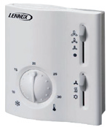
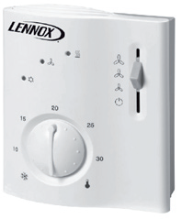
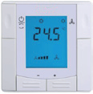
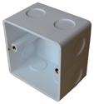
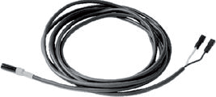
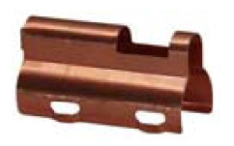
FORMER RANGE VS NEW ONE
Overview of the former range
Electromechanicals Thermostat LXRAB10
LXRAB30
Electronics thermostat
LXRCC10
LXRCC20
LXRCC30
RDF300.02
Accessories
ARG71
QAH11.1
ARG86.3

Slide 3
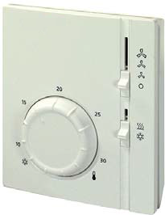
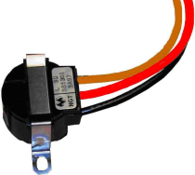
FORMER RANGE VS NEW ONE
analysis of change
Electromechanicals Thermostat
LXRAB10 – 2p – 3speeds - manual C/O LXRAB30 – 4p – 3speeds - manual C/O
LXRAB31 – 2p / 2p+EH / 4p – 3speeds - manual C/O
New accessories linked to this thermostat
C/0 38505 – Change over thermostat
1 reference instead of 2
and one more application

Slide 4
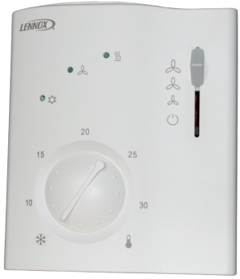
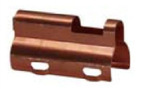
FORMER RANGE VS NEW ONE
analysis of change
Electronics thermostat
LXRCC10 – 2p – 3speeds – automatic C/O
LXRCC20 – 4p – 3speeds - automatic C/O
LXRCC30 – 4p – 3speeds - automatic C/O
LXRCC20 – 2p/2p+EH/4p – 3speeds - automatic C/O
Accessories linked to this thermostat
QAH11.1 ARG86.3
1 reference instead of 3
same application

Slide 5
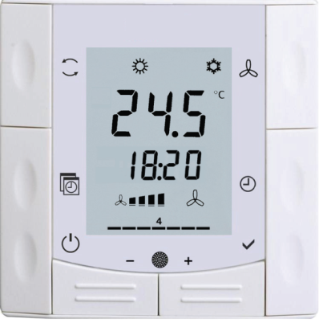
FORMER RANGE VS NEW ONE
analysis of change
Electronics thermostat
RDF300.02NL + ARG71
RDF600T
Why it is better?
for round CEE box, with min 60 mm diameter, min 40 mm depth
Timer function included
Accessories linked to this thermostat
QAH11.1 ARG86.3

Slide 6
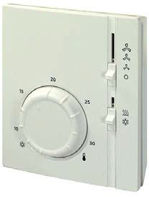
LXRAB31
General features
Large rotary setting knob for temperature setpoint
No power required since switching actions are performed by a gas diaphragm
Internal limiter for setpoint limitation
Manual selection of 3 fan speeds
Manual change-over
3 x Output for 3-speed (6A)
2 x Output valve (230V on/off) or electrical heater
A jumper allow to select - Selected fan speed as continuous operation - Fan is switched at the same time as the valve
Applications
2p / 2p + Electrical Heater / 4p

Slide 7
LXRAB31
Fan speed
There are two choices of jumper positions available on printed circuit board:
SR1 Selected fan speed as continuous operation
SR2 Fan is switched at the same time as the valve, depending on the switch position.
The setpoint setting range can be mechanically limited by means of setpoint limiter
under the cover.

Slide 8
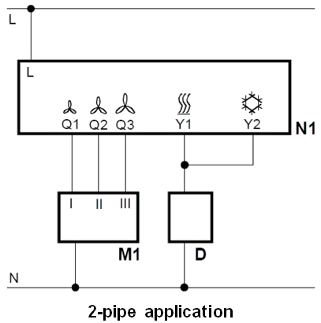
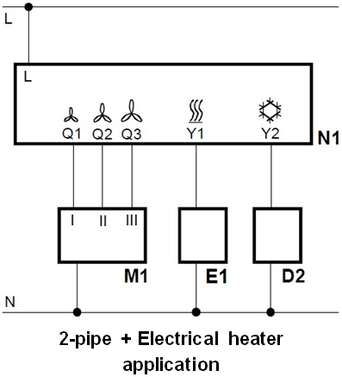
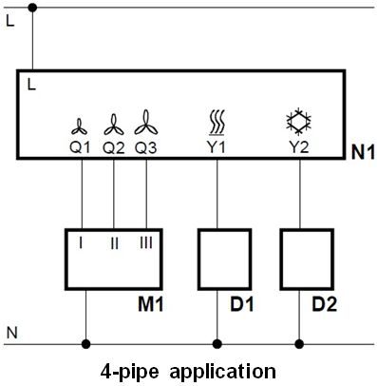
LXRAB31
Connection diagram L Switching voltage AC 250 V
N Neutral
Q1 Control output "Fan speed I", AC 250 V (6A)
Q2 Control output "Fan speed II", AC 250 V
Q3 Control output "Fan speed III", AC 250 V
Y1 Control output "Valve actuator heating" or Electrical heater, AC 250 V (6A)
Y2 Control output "Valve actuator cooling", AC 250 V

Slide 9
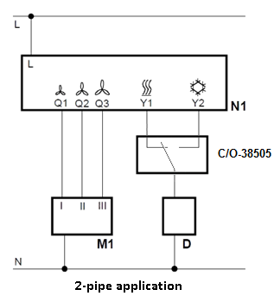
LXRAB31
Connection diagram variant L Switching voltage AC 250 V
N Neutral
Q1 Control output "Fan speed I", AC 250 V (6A)
Q2 Control output "Fan speed II", AC 250 V
Q3 Control output "Fan speed III", AC 250 V
Y1 Control output "Valve actuator heating" or Electrical heater, AC 250 V (6A)
Y2 Control output "Valve actuator cooling", AC 250 V
In 2p application we can use the thermostat to ensure the suitability of the request and the water temperature
C/O-38505

Slide 10
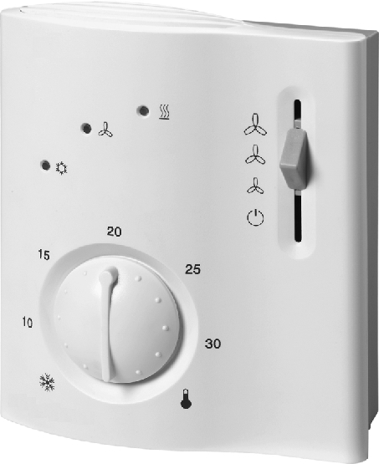
LXRCC20
General features
Outputs for on / off valve actuator and electrical heater
Output for three-speed fan
Control depending on the room/return air temperature
Automatic heating / cooling changeover
Operating modes: normal, energy saving and frost protection mode or OFF
Operating mode changeover input for remote control
Selectable control parameters
Operating voltage AC 230 V
Applications
2p / 2p + Electrical Heater / 4p

Slide 11
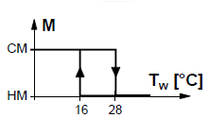
LXRCC20
Automatic changeover
changeover sensor (QAH11 + ARG86.3)
When the water temperature lies above 28 °C, the controller switches to heating mode, below 16 °C it switches to cooling mode.
Energy saving mode
the setpoint of heating is 16°C and the setpoint of cooling 28 °C, independent of the position of the setpoint knob. This operating mode will be activated when input D1 for operating mode changeover is active and DIP switch no.2 is set to ON.

Slide 12
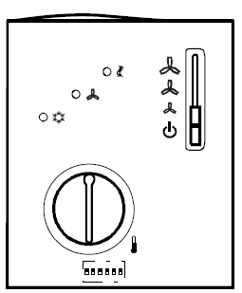
LXRCC20
Set of DIP switches
1 Fan control ON : Fan control is temperature dependent in all operating modes
OFF : Fan control in normal operation is temperature-independent
2 Operating mode changeover ON : Changeover between normal operation and energy saving mode
via an external switch OFF : Changeover between normal operation and standby
3 Operating action of switch ON : Changeover activated when contact of switch is closed (N.O.)
for external operating OFF : Changeover activated when contact of switch is open (N.O.)
mode changeover
4 Standby ON : Frost protection function not enabled
OFF : Frost protection function enabled
5 Switching differential ON : 1 K in heating mode 1) 0.5 K in cooing mode
OFF : 4 K in heating mode 2 K in cooling mode
6 Dead zone in normal operation ON : 2 K
OFF : 5 K
7 Setpoint differential ON : 2 K
OFF : 4 K
8 Electrical heater ON : Active in cooling mode
OFF : Inactive in cooling mode
Factory setting

Slide 13
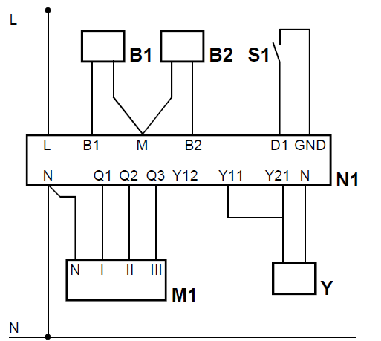
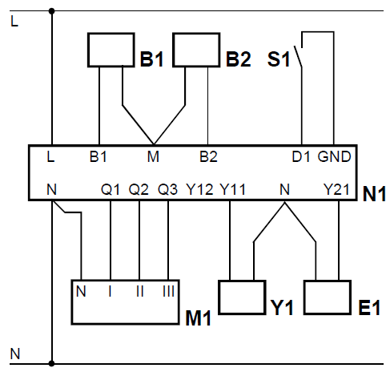
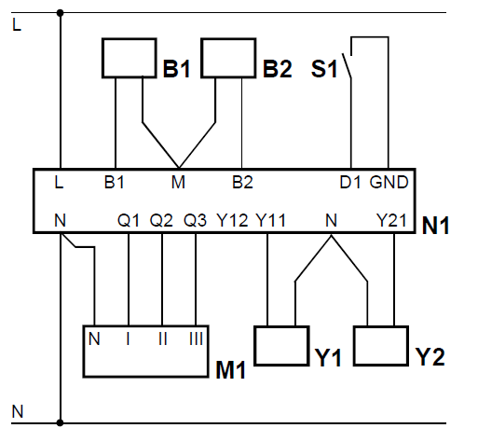
LXRCC20
Connection diagram B1 Return air temperature sensor (QAH11)
B2 Changeover sensor (QAH11 temperature sensor + ARG863.3)
S1 External operating mode changeover switch
Y Zone valve or thermal valve for heating or cooling
Y1 Zone valve or thermal valve for cooling
Y2 Zone valve or thermal valve for heating
E1 Electrical heater (1250VA max)
L Switching voltage AC 250 V
M1 3-speed fan
N Neutral
N1 Room thermostat
Q1 Control output "Fan speed I", AC 230 V (max 600VA)
Q2 Control output "Fan speed II", AC 230 V (max 600VA)
Q3 Control output "Fan speed III", AC 230 V (max 600VA)
Y11 Control output "Valve actuator cooling", AC 230 V (max 300VA)
Y21 Control output "Valve actuator heating" or Electrical heater, AC 230 V (max 1250VA)
2-pipe application
2-pipe + Electrical heater application
4-pipe application

Slide 14
RDF 600T (not suitable for EC motor)
General features
AC 230V operating voltage
Output for 3-speed
2 multifunctional inputs for keycard contact, external sensor, etc.
Operating modes: Comfort, Economy and Protection
Automatic or manual fan speed control
Automatic or manual heating/cooling changeover
Adjustable commissioning and control parameters
Minimum and maximum setpoint limitation
Backlit LCD
Auto Timer mode with 8 programmable timers
Type of mounting / suitable conduit boxes for round CEE box, with min 60 mm diameter, min 40 mm depth

Slide 15
RDF 600T (not suitable for EC motor)
Application
2-pipe fan coil units
2-pipe fan coil units with electric heater
4-pipe fan coil units
Control
3-speed fan
One or 2 on/off valve actuators
One on/off valve actuator and one 1-stage electric heater
One 3-position valve actuator
Automatic heating/cooling changeover
Manual heating/cooling changeover
Heating and cooling mode (e.g. 4-pipe system)

Slide 16
RDF 600T (not suitable for EC motor)
Functions
built-in temperature sensor or external room/return air
Automatic or manual changeover
Select operating mode via the operating mode button on the thermostat
3-speed fan control (automatic or manual)
Minimum and maximum setpoint limitation
Button lock (automatic and manual)
2 multifunctional inputs, freely selectable (Operating mode switchover contact (key card), Dewpoint sensor, Electric heater enable, Alarm input)
Advanced fan control function, i.e. fan kick, fan start, selectable fan operation (enable, disable or depending on heating or cooling mode)
Purge function together with 2-port valve in a 2-pipe changeover system
Reminder to clean filters
Display current room temperature or setpoint in °C and/or °F
7-day time program: 8 programmable timers to switch over between Comfort and Economy mode

Slide 17
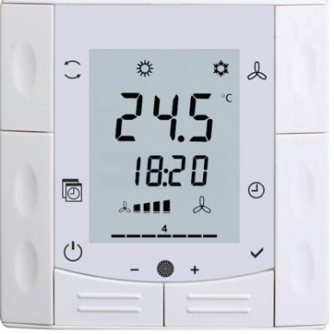
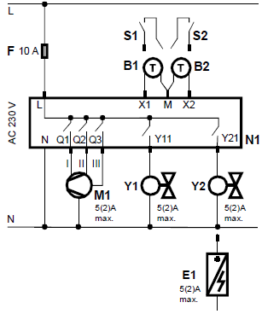
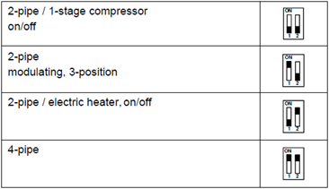
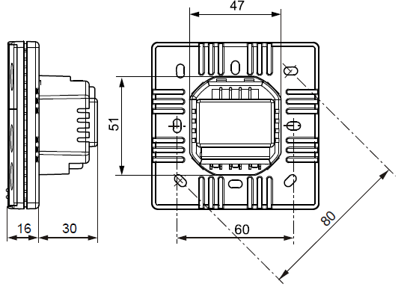
RDF 600T (not suitable for EC motor)
Connection diagram

