Slide 1
R@CKCOOLAIR
High Density Cooler
Olivier Lenglet
Airside/CCU Product Manager
Olivier LENGLET – the 24th of April 2013

Slide 2
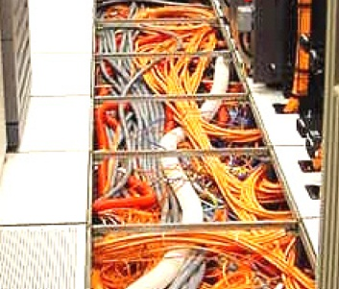
R@CKCOOLAIR APPLICATION OVERVIEW
The R@CKCOOLAIR ranges can be used for
In-Row application with cold or hot aisle
or
In-Rack application.
Placed close to the Server itself
  Less ventilation consumption
  no need to overcome pressure drops from ducting or raised floor systems.
  EC plug fan
    maximum stability in airflow even in most packed Server-racks
    Airflow modulation according to the heat load reduce the electrical consumption
Keep in your mind that : Fan consumption = k*[Air Flow]³
        No problem with raised floor
          Usually when the data center requirements change the raised floor becomes clogged with cables which then obstruct the airflow to the diffusion grid. Degrading the quality of the cooling and increasing the pressure drop and then the energy consumption

Slide 3
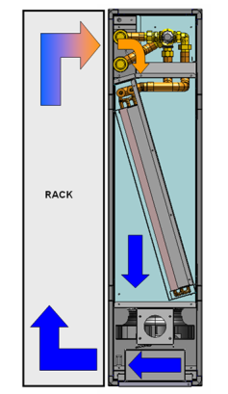
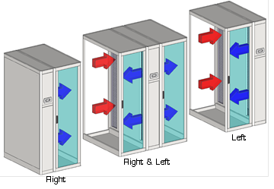
APPLICATION OVERVIEW
    IN-RACK
    Designed to cool down the server-rack only.
    Spot cooling solution : where and when you need it
    Two temperature control zones
    Management of two different zones, top and bottom,
    To match with the distribution of appliances in the rack
Airflow configuration
              Only for the units 300mm wide and 1200mm long
                For server-rack
                42U (2000mm) and 46U(2200mm).
                server-racks have to be equipped with doors and back with solid panels or glass-doors.

Slide 4
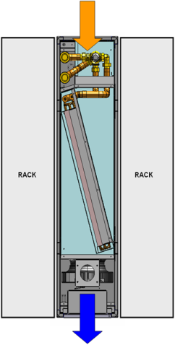
APPLICATION OVERVIEW
    IN-ROW
    Designed for hot or cold aisle.
    HOT/COLD AISLE BENEFITS
      No mixing of hot and cold air.
      The cooling system can be set to a higher temperature
      Efficiency significantly improved
      Less dehumidification
Traditional installation
Cold aisle installation

Slide 5
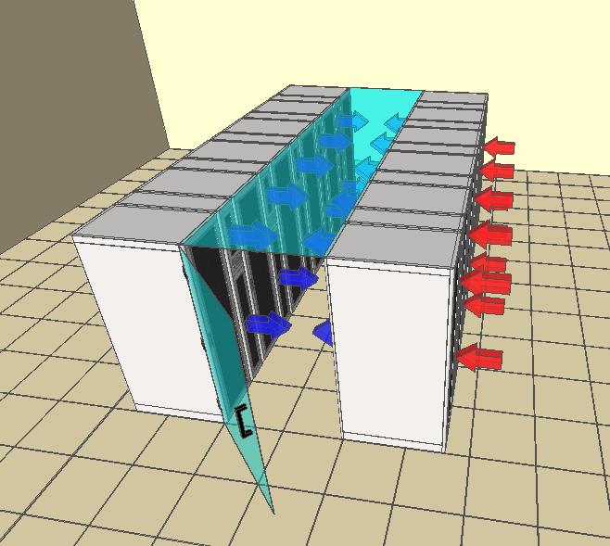
APPLICATION OVERVIEW
Pressure control
This installation required pressure control
Why ?
overpressure in the aisle could damage the server,(maxi 10Pa)
keeping the pressure at the same level
than outside we avoid air leakage
and trouble with door opening.
Our advanced control with the EC fans
allow such precise control.

Slide 6
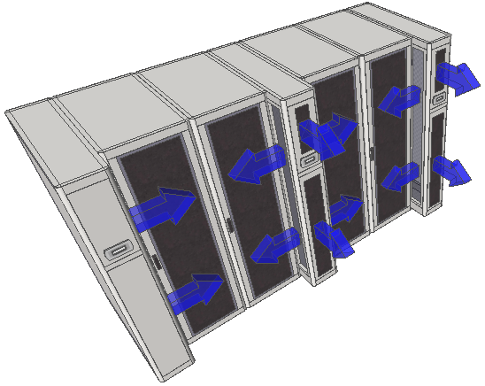
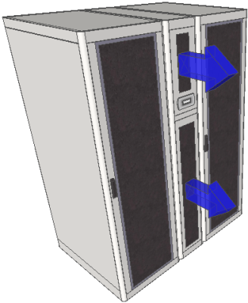
APPLICATION OVERVIEW
In-Rack Airflow configurations
The different possibilities of airflow configuration, allow many solutions.
Below on left the traditional one with rack and unit at the same dimension 1000mm or 1200mm.
On the right other possibilities with 1200mm units and 1000mm racks.
The discharge can be at the end or/and right, left you can imagine any combination.

Slide 7
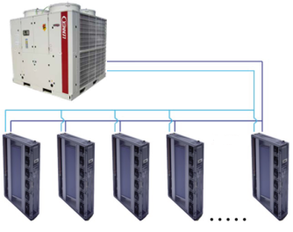
THE RANGE
VERSIONS
RHC – Chilled water
Modulating water valve
Large heat exchanger surface
Highest specific cooling capacity (W/m2)
EC Plug fan
Precise temperature control (PID type regulation)
Possibility to increase return air temperature,
thus to rise – while keeping the cooling capacity stable – the medium chilled water temperature. This results in a maximized EER of the chiller and extends the Free-Cooling operation.
.
.
RHC |  | 0200 | 0250 | 0450 | 0510
Total Cooling Capacity | kW | 22 | 28.6 | 42.9 | 58.2
Airflow | m3/h | 4000 | 5300 | 9000 | 11000
Width | mm | 300 | 300 | 600 | 600
Indoor Conditions 30°C 35% r.h.

Slide 8
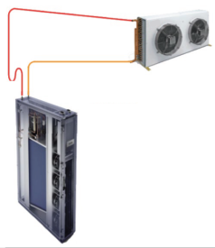
THE RANGE
VERSIONS
RND – Direct Expansion
Remote condenser
Variable speed BLDC compressors
Precise temperature control (PID type regulation);
Reduced power consumption at partial load;
Avoiding of electrical peaks and the compressor’s
mechanical stress in ON/OFF cycles;
Extension of the application field.
.
.
RND |  | 0100 | 0260 | 0400 | 0450
Total Cooling Capacity | kW | 11.2 | 25.8 | 40.0 | 44.7
Airflow | m3/h | 2700 | 5000 | 9000 | 9000
Width | mm | 300 | 600 | 600 | 600
Indoor Conditions 30°C 35% r.h. ; Outdoor Conditions 35°C

Slide 9
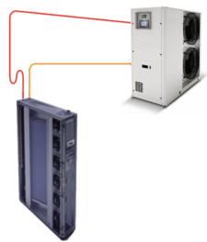
THE RANGE
VERSIONS
RNV – Direct Expansion
With condensing unit
Variable speed BLDC compressors
Precise temperature control (PID type regulation);
Reduced power consumption at partial load;
Avoiding of electrical peaks and the compressor’s
mechanical stress in ON/OFF cycles;
Extension of the application field.
.
.
RNV |  | 0140 | 0240 | 0330
Total Cooling Capacity | kW | 12.8 | 24.2 | 33.5
Airflow | m3/h | 3100 | 4400 | 4400
Width | mm | 300 | 300 | 300
Indoor Conditions 30°C 35% r.h. ; Outdoor Conditions 35°C

Slide 10
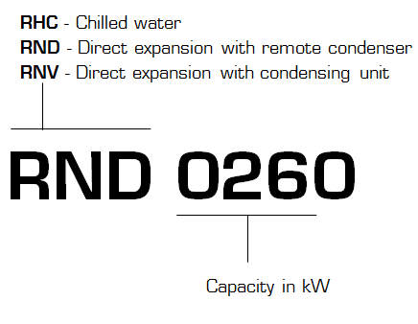
THE RANGE
CODIFICATION
RHC
RND
RNV
10 20 30 40 50 60 Capacity kW

Slide 11
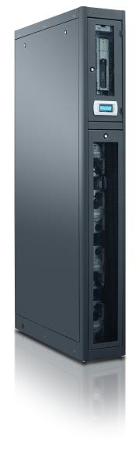
THE RANGE
STRUCTURE DESCRIPTION
Self-supporting frame
All sheet metals are galvanized and all external panels are
powder coated RAL 7035
All fixing elements are made in stainless steel or in
non-corroding materials.
The drain pan is made in stainless steel
All panels are thermally insulated with a polyurethane foam
class 1 according UL 94 norms:
this material, thanks to the open cells, gives good performances
in sound absorption.
.
.

Slide 12
THE RANGE
ELECTRICAL CONTROL BOARD
Electric control board in accordance with Directives 73/23/EEC
and 89/336/EEC and related standards.
The board may be accessed through a door after the main switch
has been turned off.
All the remote controls use 24 V signals powered by an insulating
transformer situated on the electric control board.
The mechanical safety devices such as the high pressure switched
are of the kind that trigger directly;
their efficiency will not be affected by any faults occurring in the
microprocessor control circuit, in compliance with 97/23 PED.
Warning :
For RNV range the power supply to the indoor and outdoor unit are separated.
Especially on sizes 0240 and 0330 where we have 230V/1/50Hz for indoor and 400V/3/50Hz for outdoor.
.

Slide 13
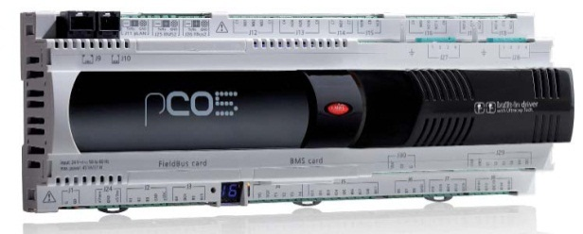
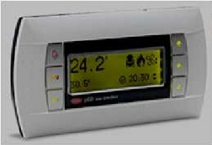
THE RANGE
ADVANCED CONTROL
The microprocessor built into the unit allows
the different operating parameters to be
controlled from a set of pushbuttons situated
on the electric control board:
Switching On/Off - Modulation of compressor
to maintain the temperature set point T inside the shelter.
Alarm management : - High / Low pressure;
- Dirty filters alarm (optional);
- Air flow alarm.
      Alarm signaling.
      Display of operating parameters.
      RS232, RS485 serial output management (optional).
      Phase sequence error (not displayed by the control, but prevents the compressor from starting up)
As standard LAN connection up to 8 units
OPTIONS
The units are equipped with their own display but you can add a remote one.
Air volume measurement - automatic constant airflow control & visualization
Delta pressure control : required for cold/hot aisle application.
Many possibilities of communication through different protocols

Slide 14
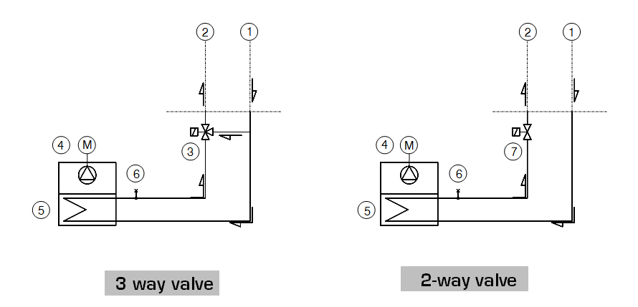
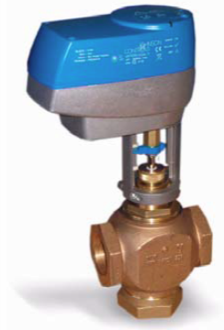
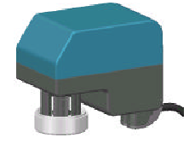

THE RANGE
RHC - COOLING CIRCUIT
Water Valve
• 3 way for constant flow systems
• 2 way valve for variable flow. In this case Free cooling application range will be
extended thanks to the increase of return water T once the load decreases.
Model | RHC0200 RHC0250 | RHC0450 RHC0510
Brand / valve’s type | Controlli / VMXT2 | Johnson / VG7802RT
PN valve | 16 | 16
Dimension (inch) | 3/4" | 1 1/2"

Slide 15
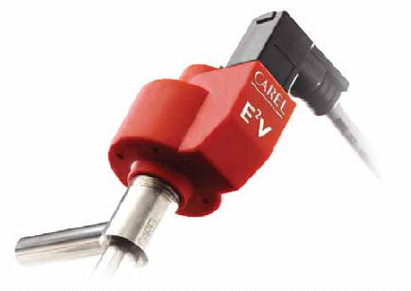
THE RANGE
REFRIGERANT CIRCUIT (RND / RNV)
Refrigerating circuit according CEE 97/23.
Units are pre-charged with dry nitrogen.
Compressors
Inverter drove BLDC Scroll compressors
Electronic expansion valve
Electronic driven valves ensures a large modulation capacity
Possibility to reduce the minimum Delta P across the valve
thus decrease the condensing T during middle and winter
seasons and then reducing energy consumption.
Cooling components
Molecular mesh activated-alumina filter dryer.
Flow indicator with humidity indicator (sight glass).
High and low pressure switches.
Schrader valves for checks and/or maintenance.

Slide 16
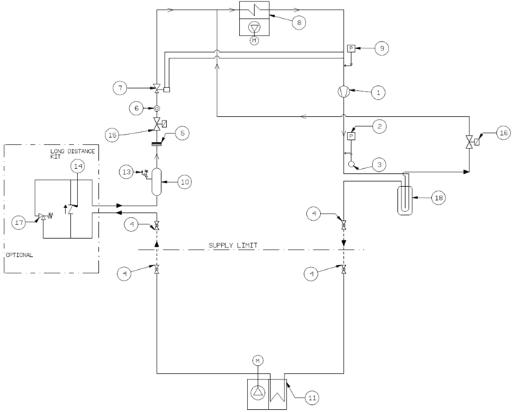
THE RANGE
RND - COOLING CIRCUIT
1 | Inverter driven compressor | 10 | Liquid receiver
2 | HP Pressure switch | 11 | Condenser
3 | Pressure probe (opt.) | 13 | Safety valve
4 | Ball valve | 14 | Check valve
5 | Refrigerant filter | 15 | Solenoid valve
6 | Sight glass | 16 | Oil solenoid valve
7 | Thermostatic valve | 17 | Long distance kit
8 | Evaporator | 18 | Oil separator
9 | LP pressure switch

Slide 17
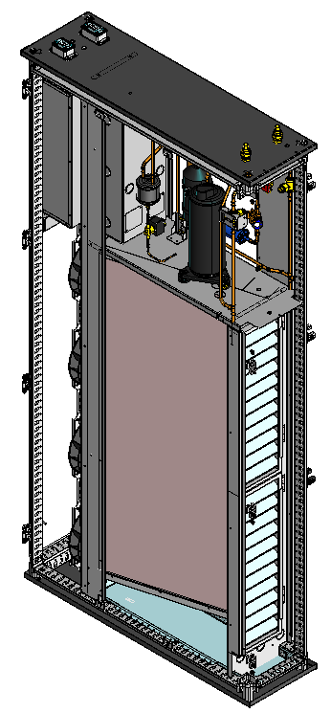
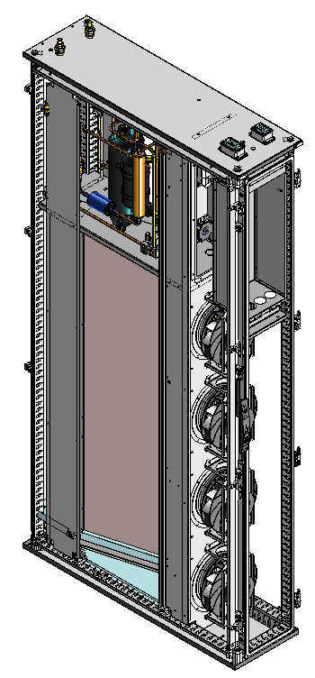
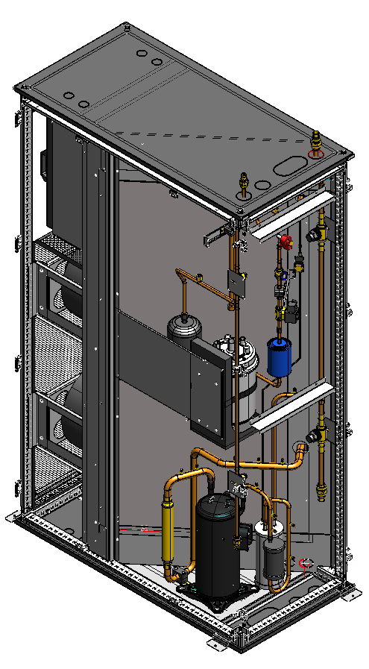
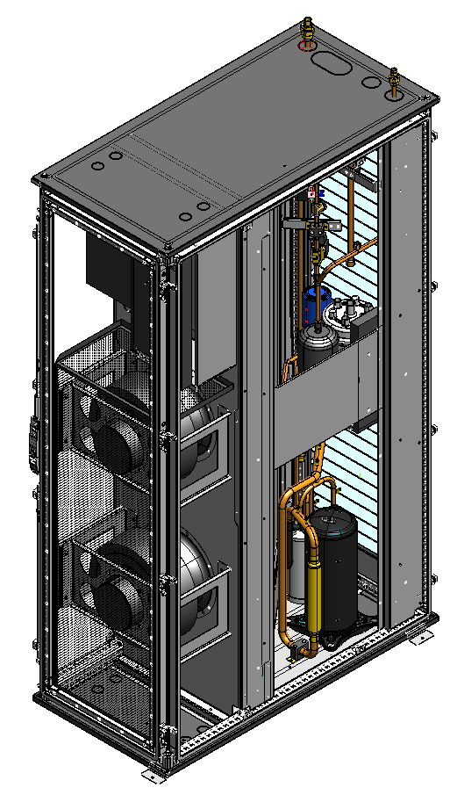
THE RANGE
RND
RND0100
RND0260
RND0400
RND0450

Slide 18
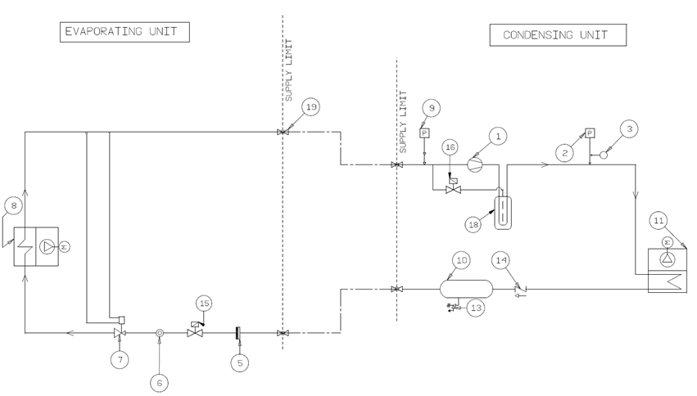
THE RANGE
RNV - COOLING CIRCUIT
1 | Inverter driven compressor | 10 | Liquid receiver
2 | HP Pressure switch | 11 | Condenser coil
3 | Pressure probe (opt.) | 13 | Safety valve
5 | Refrigerant filter | 14 | Check valve
6 | Sight glass | 15 | Solenoid valve
7 | Thermostatic valve | 16 | Oil solenoid valve
8 | Evaporator | 18 | Oil separator
9 | LP pressure switch | 19 | Shout off valve

Slide 19
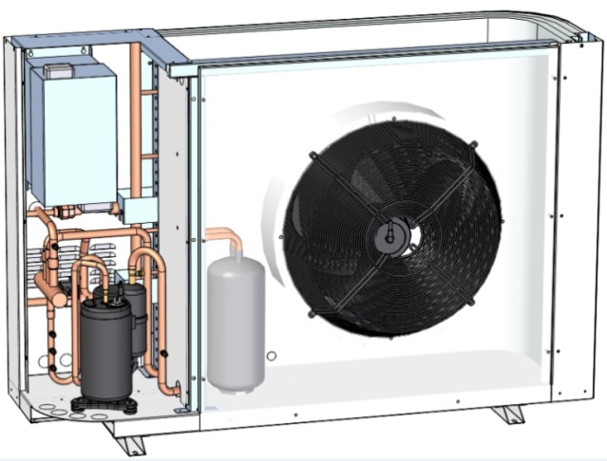
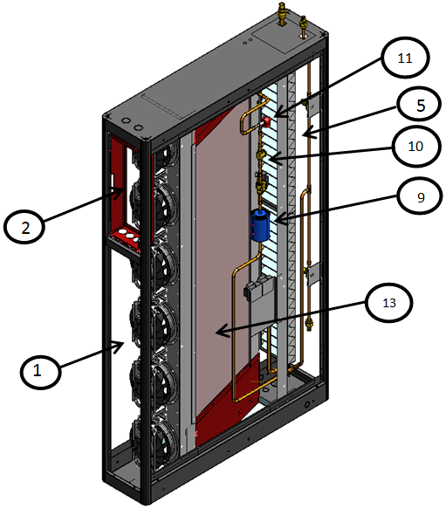
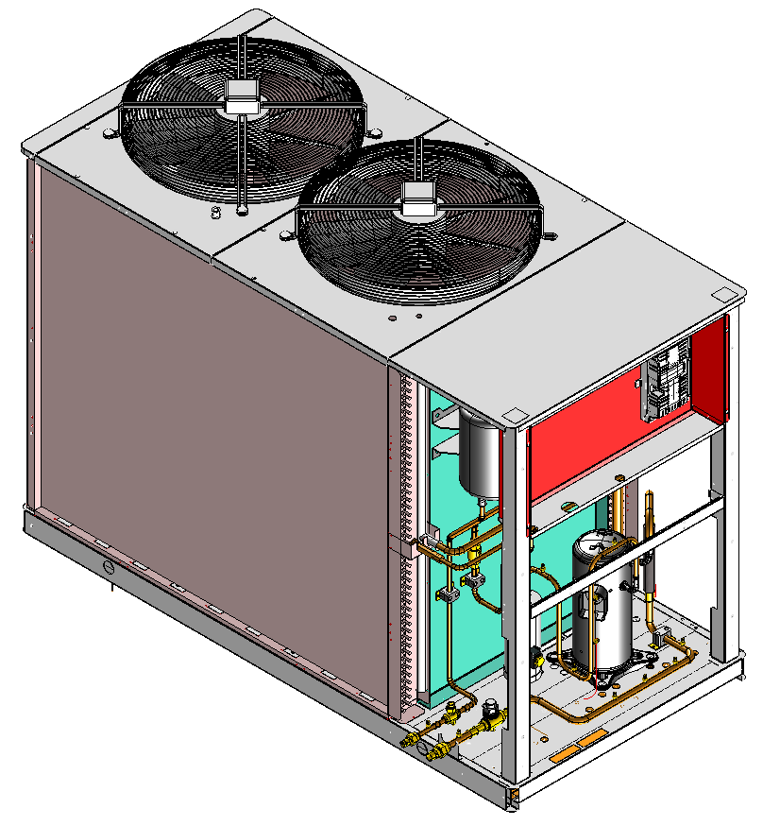
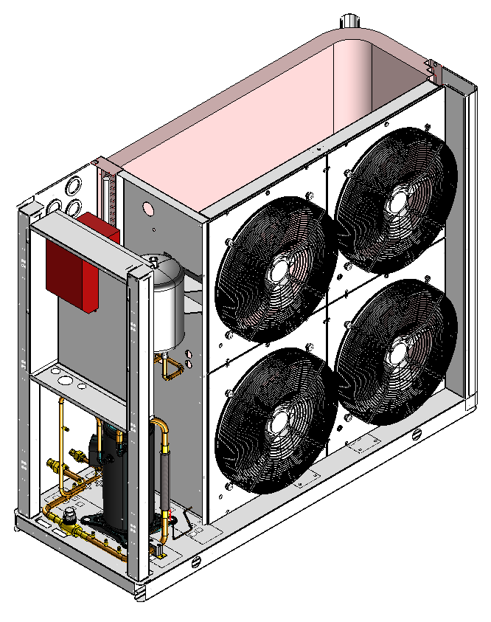
THE RANGE
RNV
RNV0140Outdoor unit
RNV0240
Outdoor unit
RNV0330
Outdoor unit

Slide 20
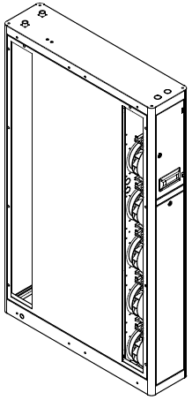
THE RANGE
CONNECTIONS
    You can choose refrigerant
    or water connections
    from the top
    Or
    from the bottom

Slide 21
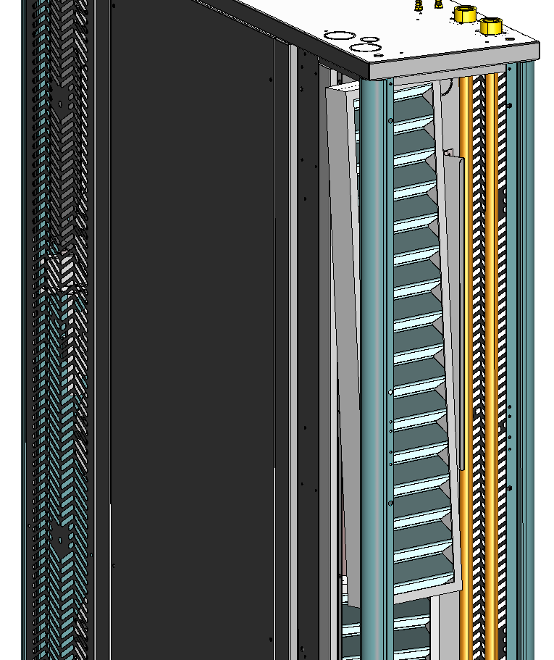
THE RANGE
FILTRATON
As standard
G3 filter
As option
  G4 filter
  M5 filter
The 3 filters can be equipped with clogged filter sensor

Slide 22
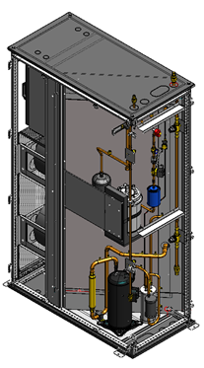
THE RANGE
HUMIDITY MANAGEMENT
  Dehumidification
  This option include humidity sensor
  Humidification
  For the 600mm width unit a steam humidifier
  can be installed in the unit

Slide 23
THE RANGE
ACCESSORIES
Water leakage detector
for chilled water is better to have…
Smoke detector
(optique)
Fire detector
(Temperature)
Condensation pump installed on board
Levelling feet
For In-rack application - In cold/hot aisle application problem with bypass underneath the unit

Slide 24
THE RANGE
SPECIFIC ACCESSORIES FOR RHC
Inlet/Outlet water temperature sensor
Water flow meter
An option including both allow to read the cooling capacity on the display

Slide 25
RANGE OVERVIEW
CONTROL OPTIONS
Remote display (cable 0.8m)
Temperature and humidity sensor indoor wall mounted
instead of internal unit sensor
Extra potential free contact ("unit ON")
Serial Port RS485 - FTT10 for LONWORKS protocol
Serial card RS485 for advanced control (Carel or Modbus protocol)
Air volume measurement - automatic airflow control & visualization
pCOweb interface board BACnet/SNMP Ethernet RJ45
pCOweb interface board BACnet/SNMP + Software DataWeb
Delta pressure control (cold aisle)

Slide 26
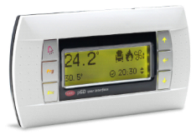
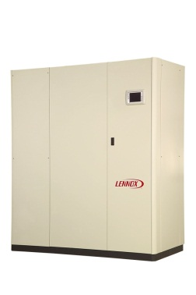
INTRODUCTION LAN & GTC

Slide 27
INTRODUCTION LAN & GTC
1) LAN
(Local Area Network)
Connexion inter-unités échange d’informations Maitre/esclave, mode secours
2) GTC
(Gestion technique centralisée)
Intégration au sein d’un systéme de contrôle du bâtiment

Slide 28

Maitre/Esclave
Nbre maxi. d’unités connectées : 8 (7 en cas d’afficheur PGD3)
Rotation de la machine de secours
Rotation de la machine de secours : automatique, zones horaires, temps de
fonctionnement.
Fonction du maitre : - éviter le fonctionnement en opposition.
        - La sonde du maitre doit être positionnée dans une position intermédiaire.
Réseau local
Unit 1
Unité 2
Unit 3
Unité 8

Slide 29
Maitre/Esclave
Connexion entre machines
Câble 1 paires blindé ( > 0.5 mm2 )
Le blindage est relié à la terre que d’un côté

Slide 30


Connexion à une GTC
Autres systèmes connectés à la GTC
Bus GTC
Unité 1
Unité 2
Unité 3
Unité N

Slide 31

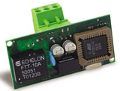
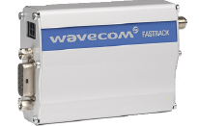



Connexion à une GTC - Protocoles
Modbus - carte série intégrée
LonWorks – carte série LonWorks
GSM - RS232 et modem GSM pour envoi de d’alarme par SMS
BACnet - avec pCOWEB – connecteur ethernet
    - avec pCOWEB – connecteur RS485
TCP/IP- SNMP - avec pCOWEB – connecteur ethernet
TREND - carte série TREND
standard OPC (OLE for Process Control). Permet une simple intégration au système client SCADA OPC. [ SCADA =Supervisory Control And Data Acquisition ] en utilisant le programme Carel OPC server.

Slide 32
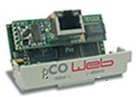
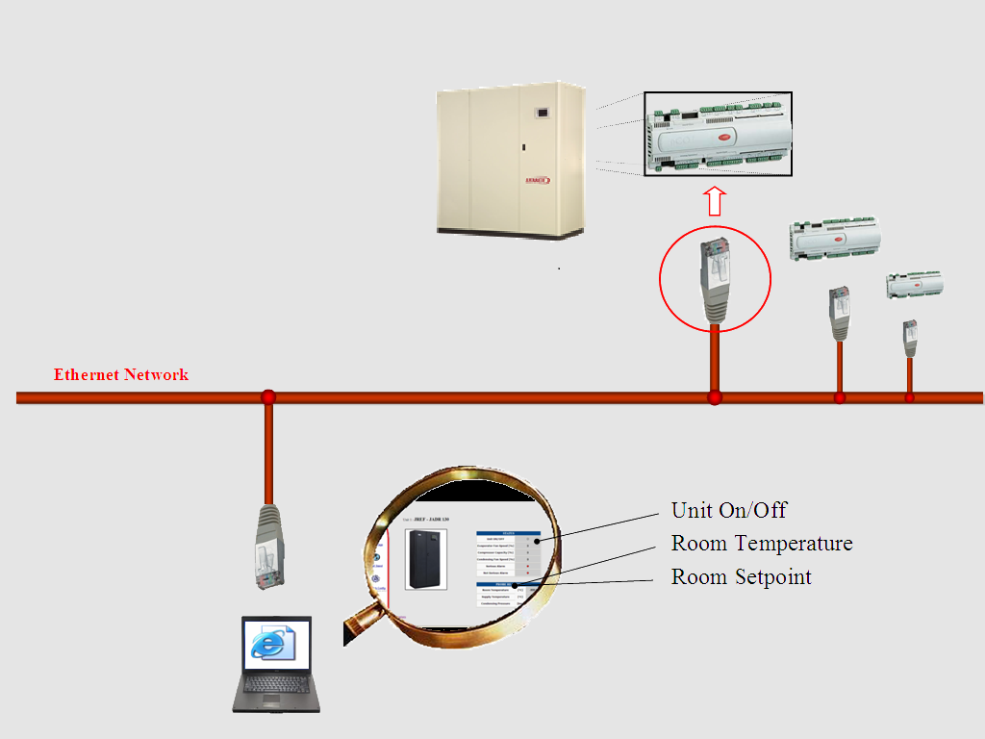
Connexion à une GTC : TCP/IP – SNMP avec la carte pCOWEB

Slide 33
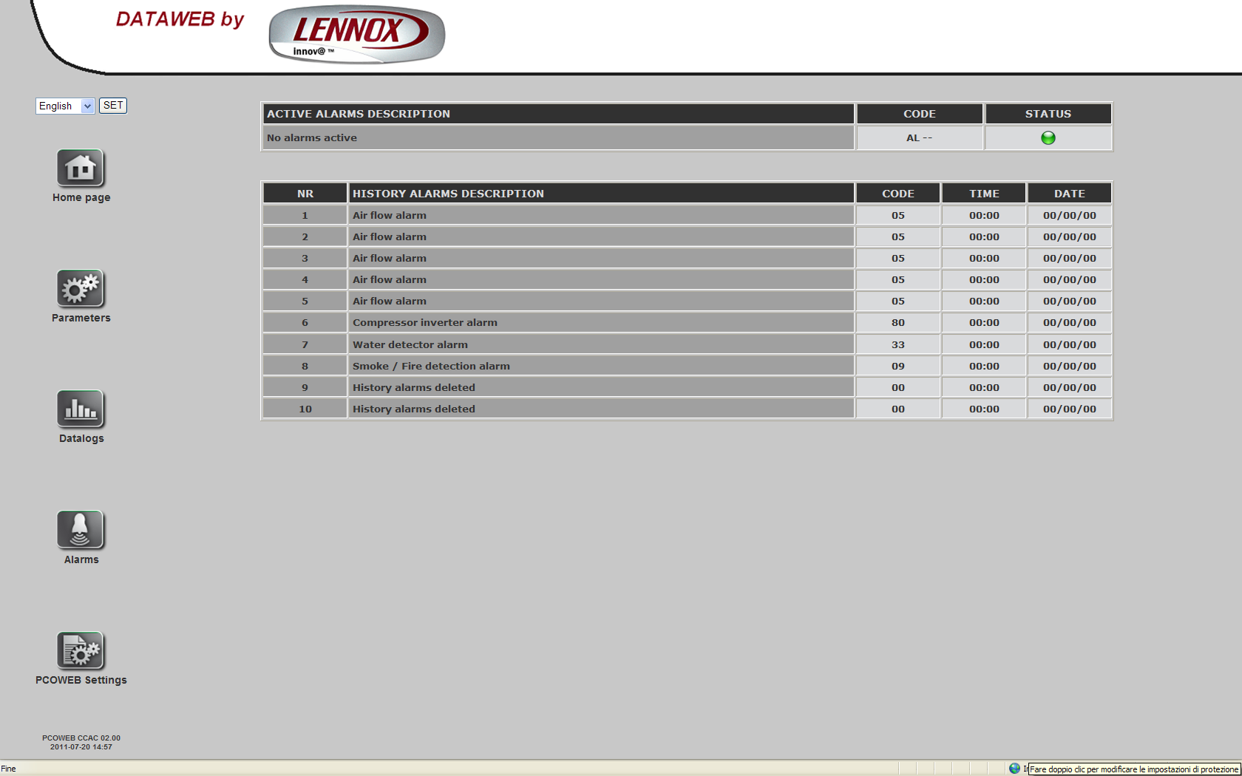
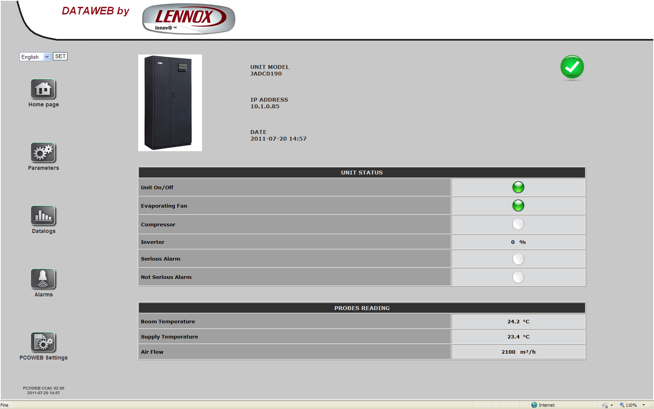
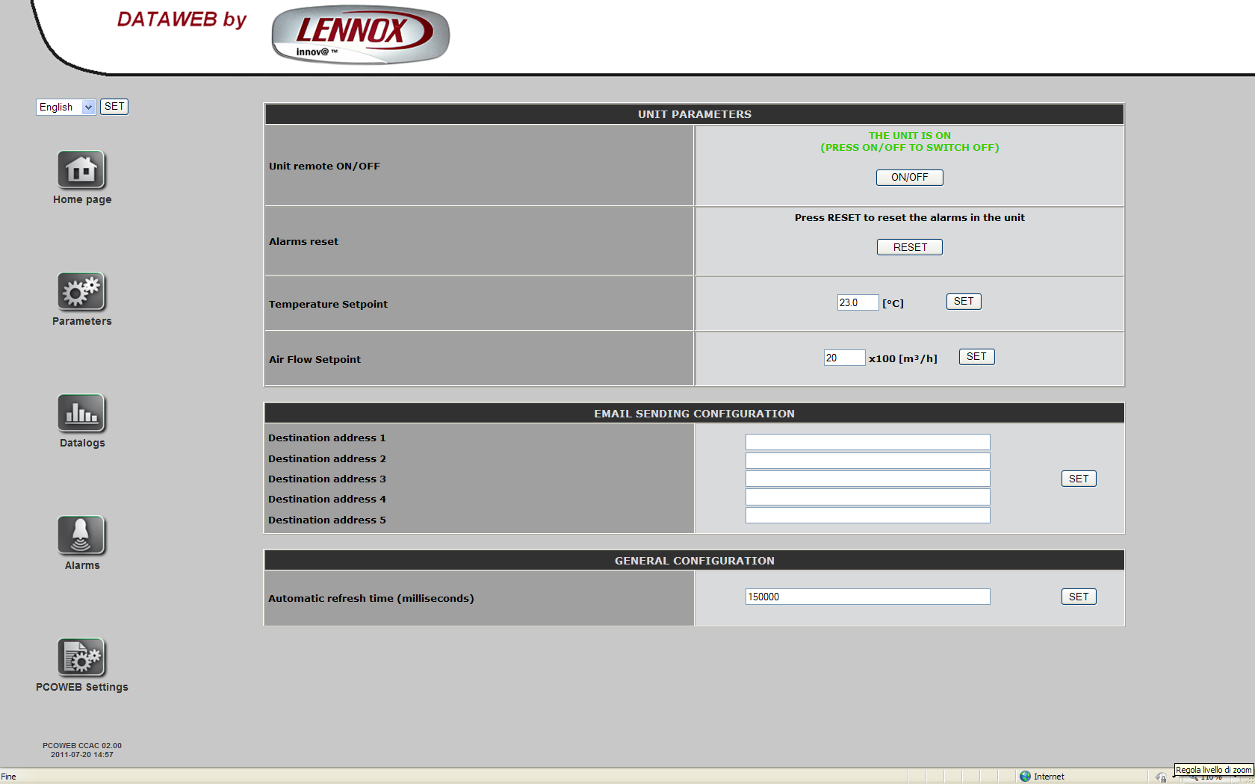
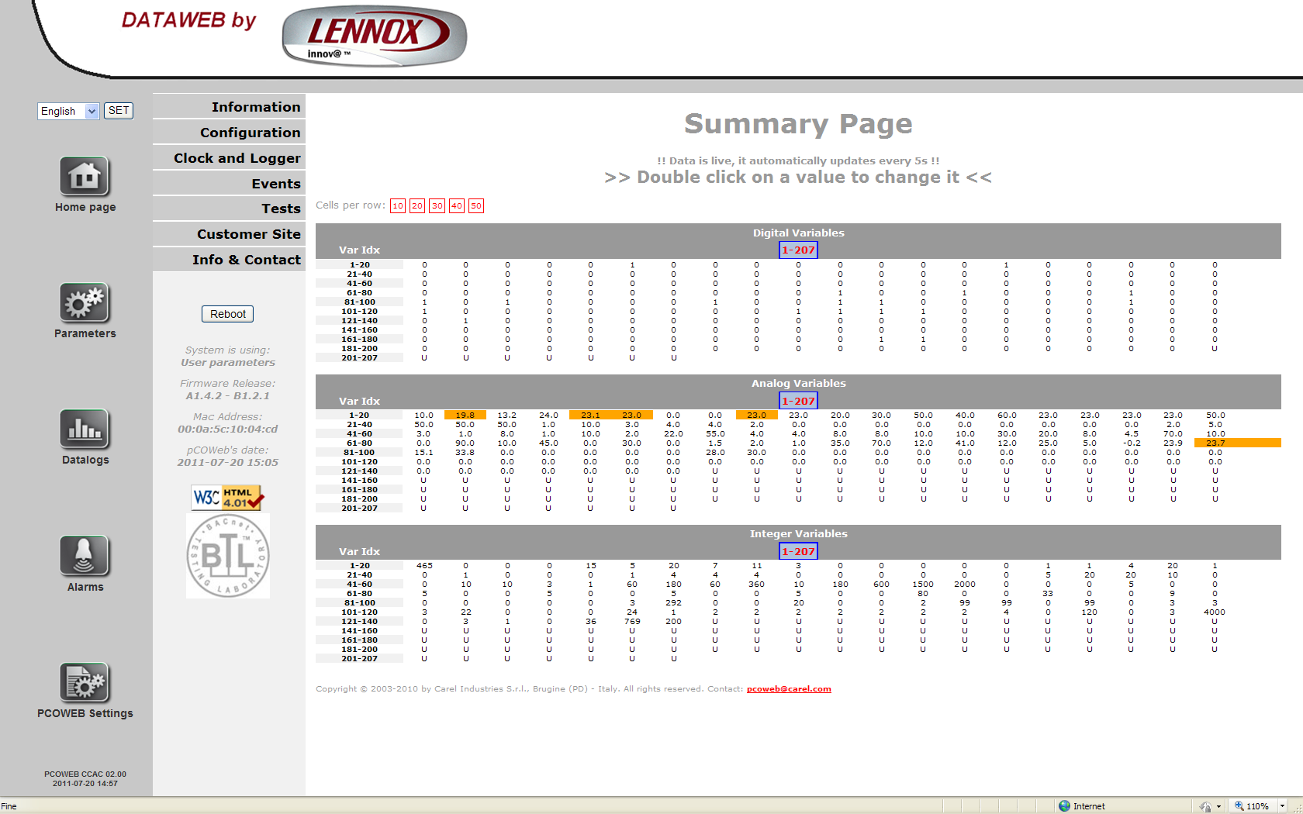
DATAWEB by LENNOX

Slide 34
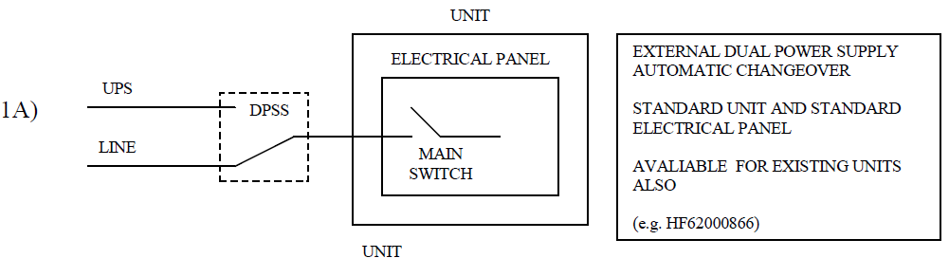
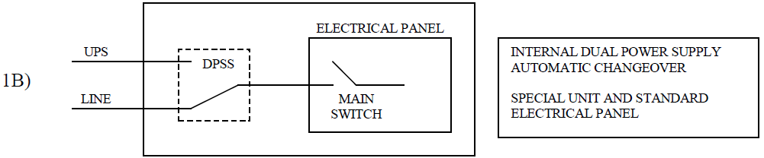
RANGE OVERVIEW
DUAL POWER SUPPLY SYSTEM ( DPSS )
This system has to be defined for the specific unit at the order according to the system it can be installed in electrical panel or separatly.
DUAL POWER SUPPLY AUTOMATIC SWITCH OVER

Slide 35
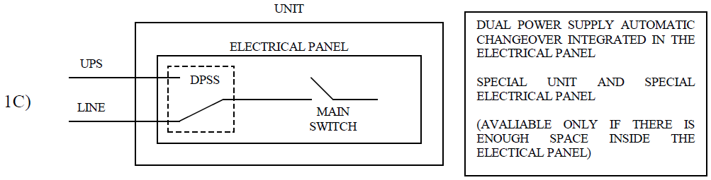
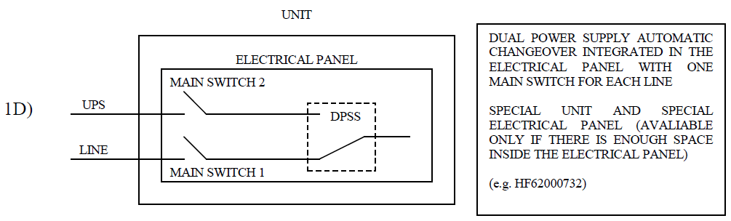
RANGE OVERVIEW
DUAL POWER SUPPLY SYSTEM ( DPSS )
DUAL POWER SUPPLY AUTOMATIC SWITCH OVER
UPS = Uninterruptible power supply

Slide 36
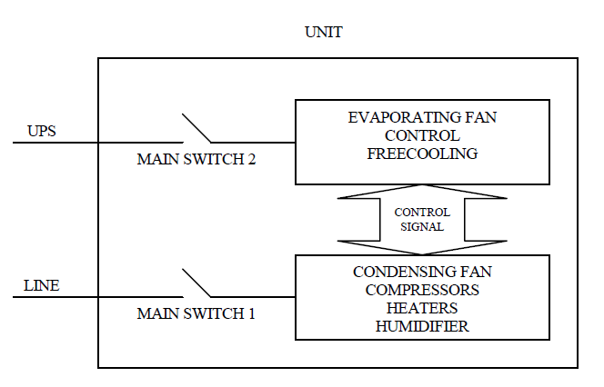
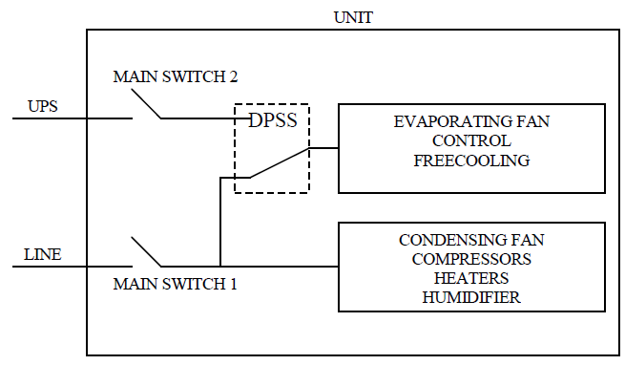
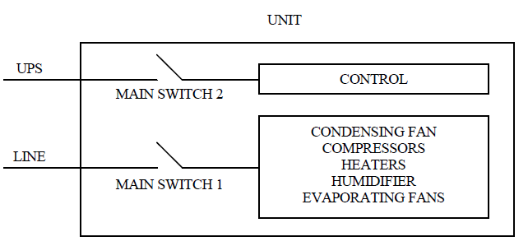
RANGE OVERVIEW
DUAL POWER SUPPLY SYSTEM ( DPSS )
DUAL POWER SUPPLY SPLIT
DUAL POWER SUPPLY AUXILIARY
SWITCH OVER
POWER AND CONTROL INDEPENDENT
SUPPLY LINE

Slide 37
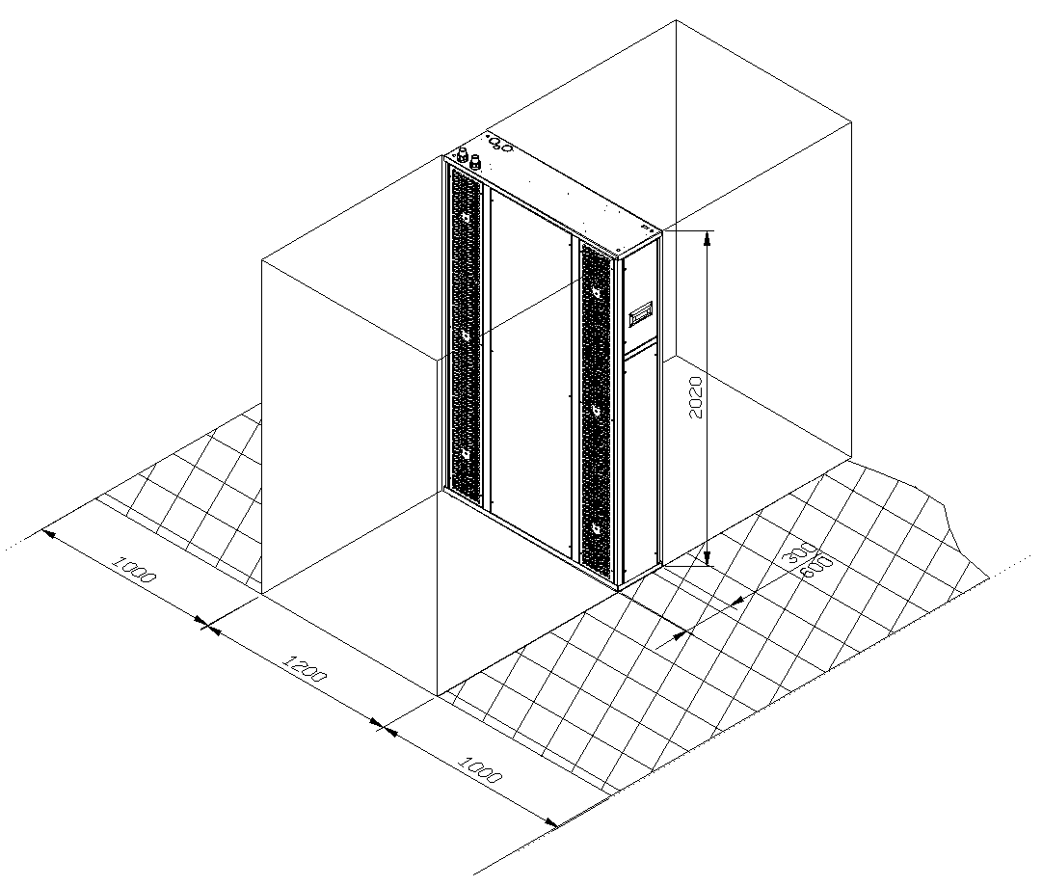
THE RANGE
CLEARANCES

Slide 38

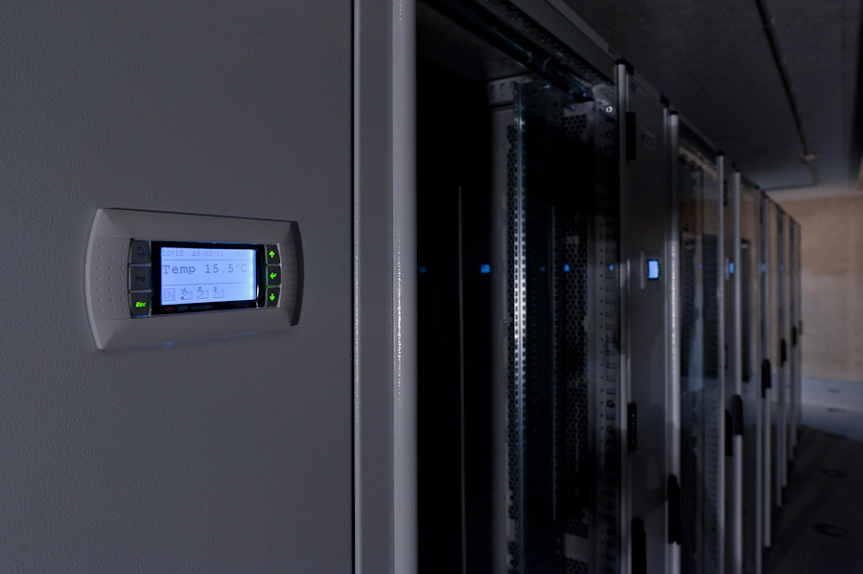

SITE
Installation “In Rack”
In the university of Dresde (Germany)

Slide 39


RACK
We can propose with our units the rack and accessories
You can download documentation from e-Lencal
Brand série SX

